Slide 1
Accelerating Student Opportunities through Emergent Collaborations
Nicholas Pohlman, PhD
Presidential Teaching Professor, Mechanical Engineering
Notes:
Sufficient title slide

Slide 2
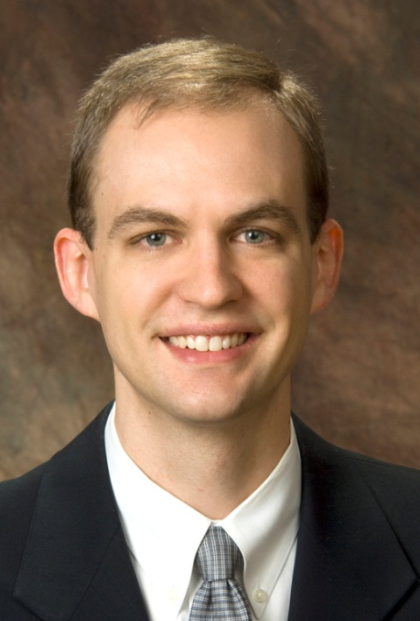


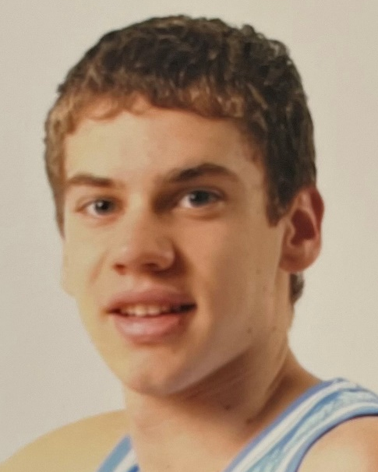
Opportunity Knocks
Newly minted PhD arriving at NIU, 2008
Luke Martin, arrived at NIU, 2013
Introduced to NICADD through Drs. Blazey and Hedin
Participated in Great Journeys and Vision 2020 initiatives
  Expanding InSET
  Established IESE
Seeking academics instead of athletics
Combo of Honors + transfer student
Convinced via the building tour of labs by Dr. Majumdar (previous MEE Dept Chair)
Images courtesy of Trinity Christian College

Slide 3
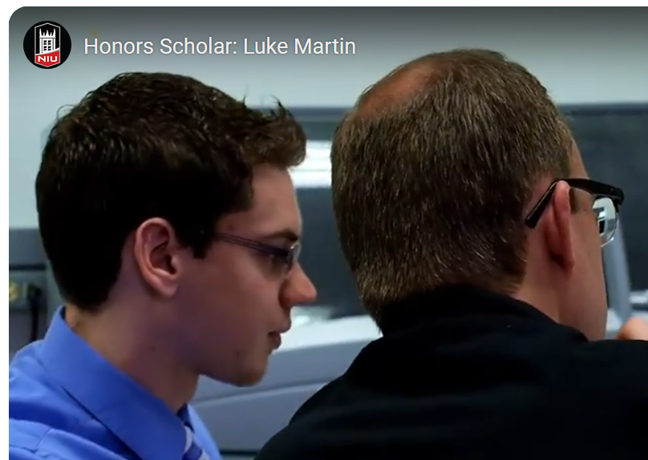
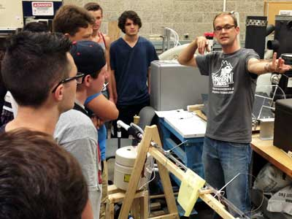
Seeking more than Academic Success
CEET Faculty of Year 2009, 2012
Honors Improvement Grant 2011
Instructor for Intro to Engineering 2011-2019
Dean’s list
Honors Scholar Award
  NIU YouTube Channel:

Slide 4
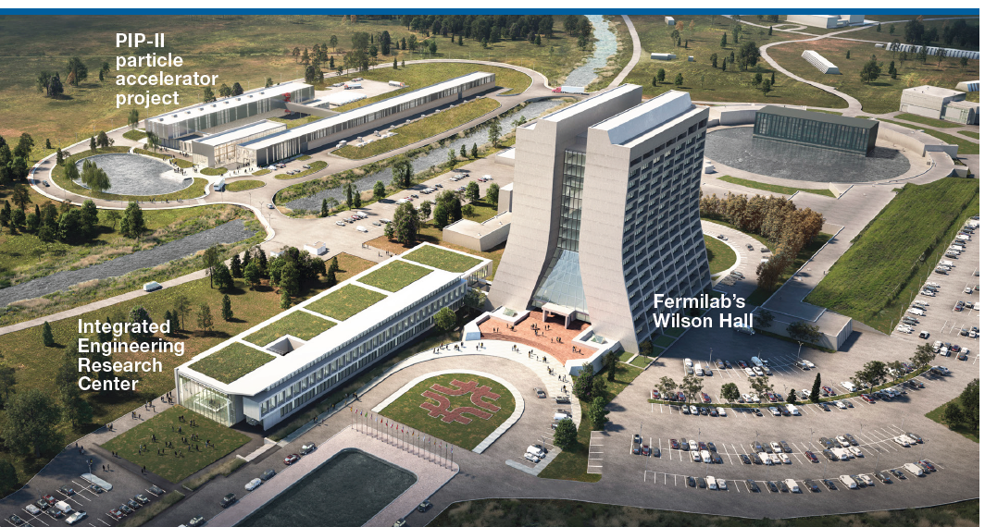
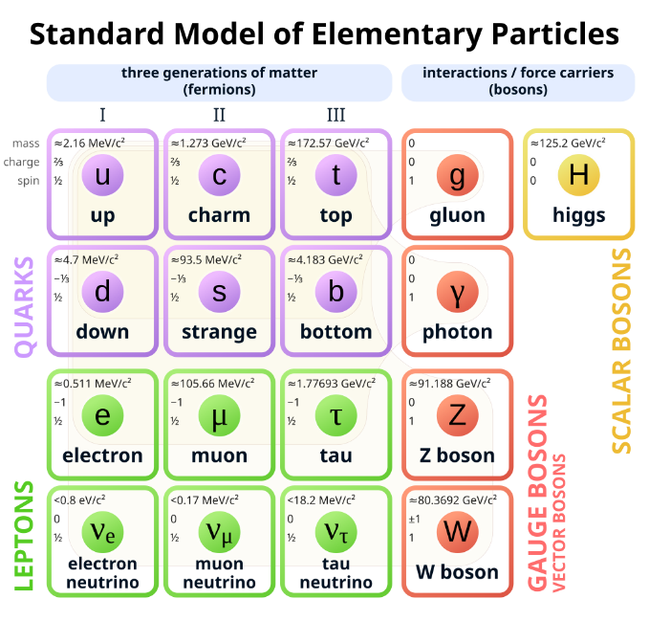

A Big Connection
Fermi National Accelerator Lab
  6,800 acre user facility in Batavia, IL
  World leader in particle physics and accelerator research
Science Focus
  Particle Physics
  Accelerators
  Detectors
  Quantum
  Emerging Tech
  Computing

Slide 5
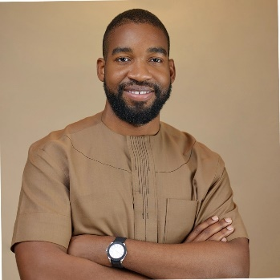
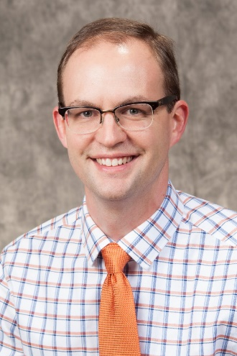
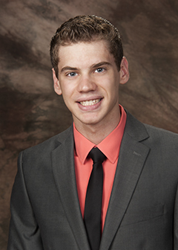
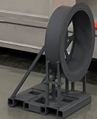
Parallel Research Path
Establishing creditability through modest grants
  Argonne Nat’l Lab (2009)
  IL Dept of Agriculture (2010)
  Environmental Protection Agency (2011)
Invited to Fermilab experiments
  Muons-to-Electrons (mu2e)
  Muon g-2
Started inquiry through tiered mentoring
  UG researcher supporting Udenna Okafor (MS 2015)
  Transitioned to Accelerated BS/MS himself (2015)
  Incorporated mu2e research into own capstone activity

Slide 6
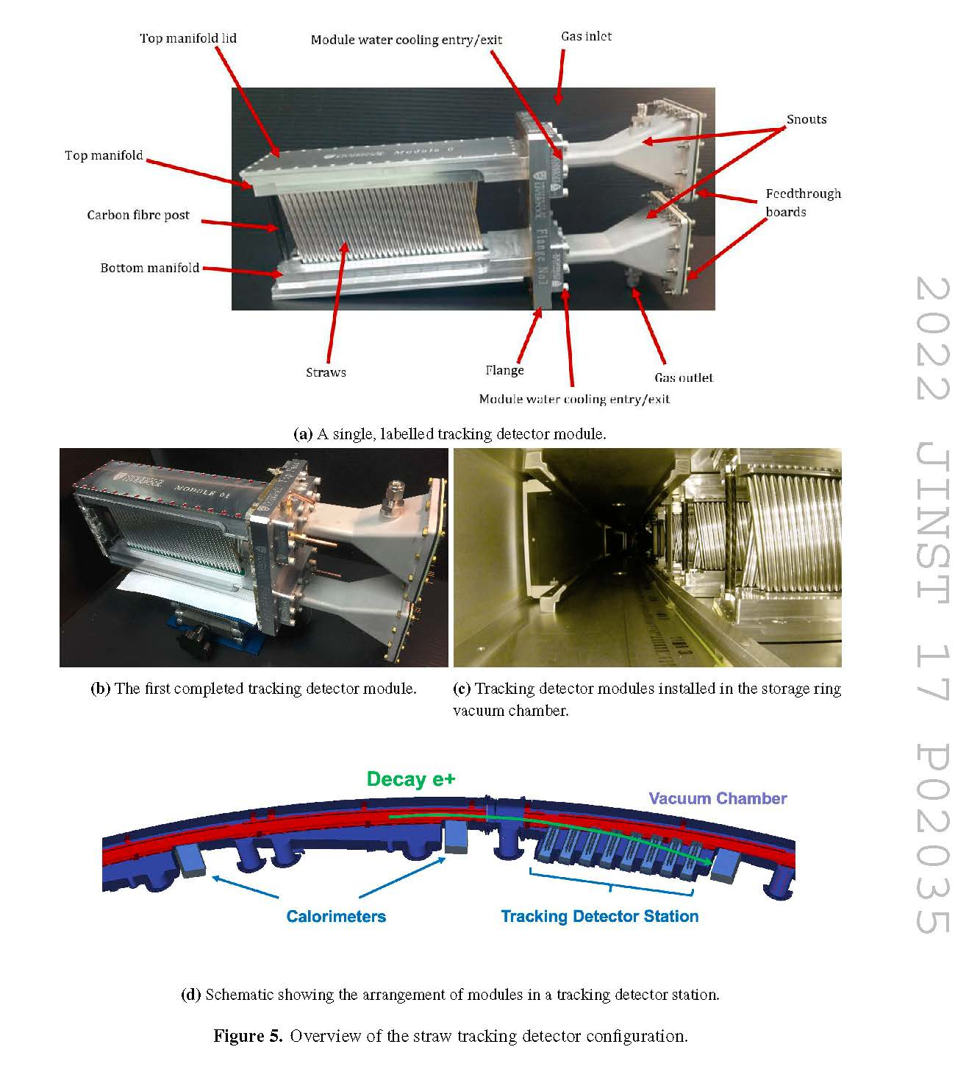
Doing the BIG thing (NP edition)
Engineering for the g-2 tracker:
  Thermal, structural, flow analysis
  Modeled and fabricated initial 32-channel prototype for beam test
Quantifiable student success
4 MS theses
9 Capstone design projects
More than 30 UG helping advance research

Slide 7
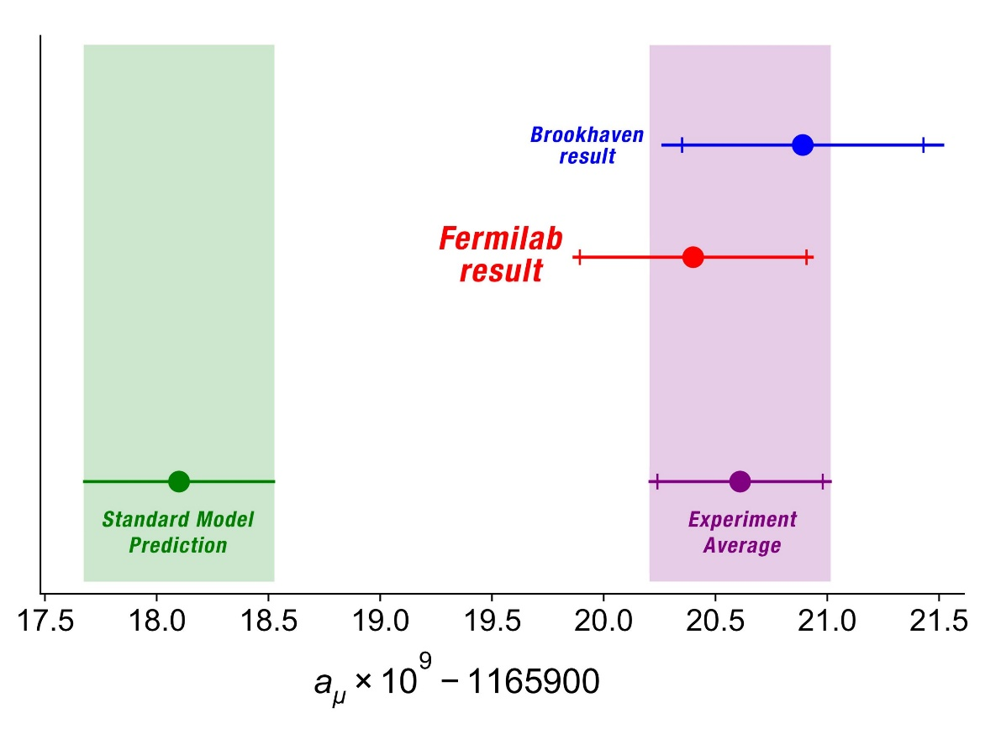
Global Impact
First results, April 2021:
  Release of 4 simultaneous publications in Physical Reviews
[1]
[1] Measurement of the Positive Muon Anomalous Magnetic Moment to 0.46 ppm, PRL, 141801. [1,039 citations]

Slide 8
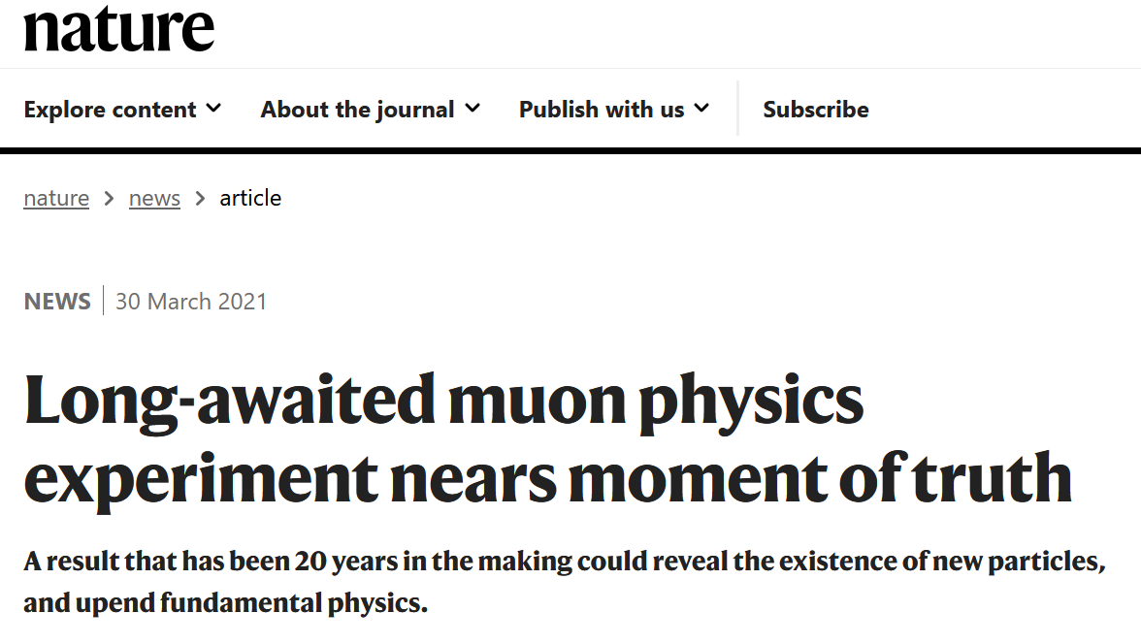
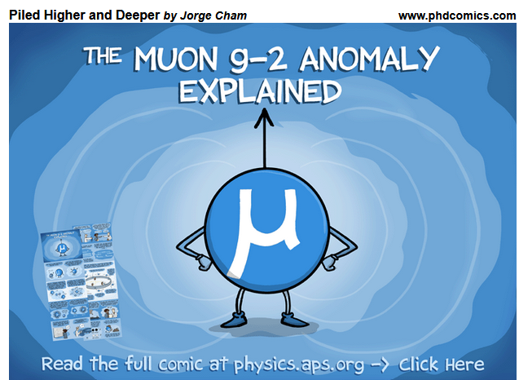
Global Impact
First results, April 2021:
  Release of 4 simultaneous publications in Physical Reviews
[1]
[1] Measurement of the Positive Muon Anomalous Magnetic Moment to 0.46 ppm, PRL, 141801. [1,039 citations]

Slide 9
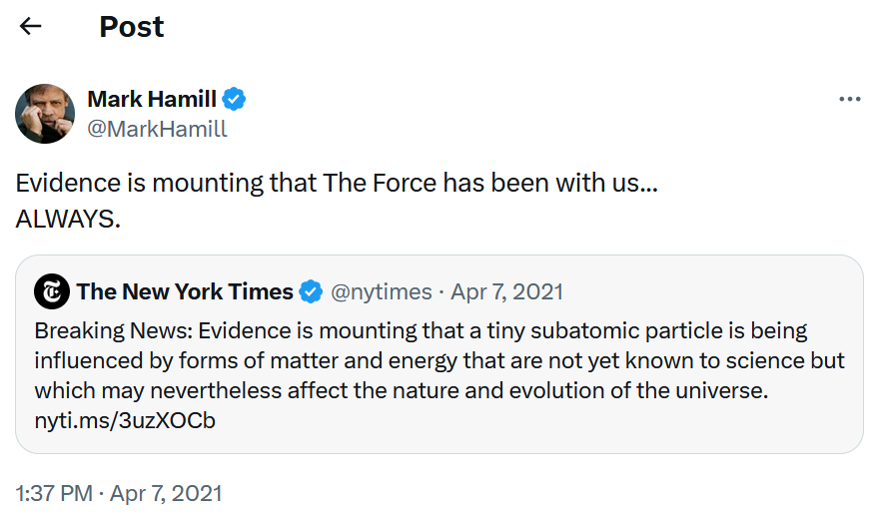
Global Impact
First results, April 2021:
  Release of 4 simultaneous publications in Physical Reviews
[1]
[1] Measurement of the Positive Muon Anomalous Magnetic Moment to 0.46 ppm, PRL, 141801. [1,039 citations]

Slide 10
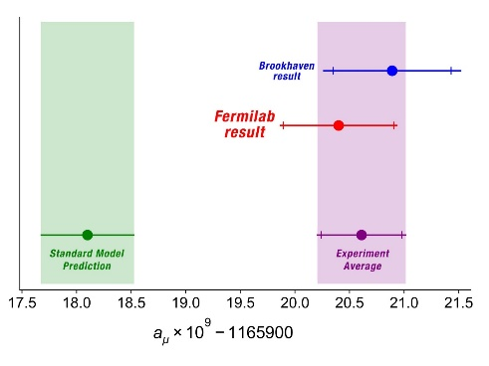
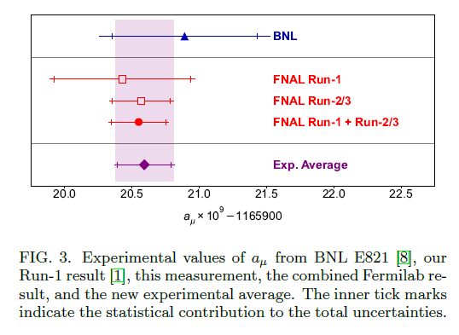
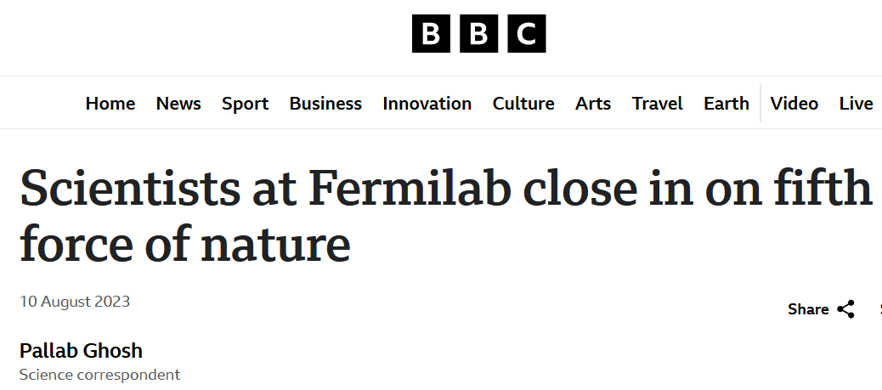
Results continue
First results, April 2021:
Tracker exceeds operational timeline
Improved results, August 2023:
[1]
[2]
[1] Measurement of the Positive Muon Anomalous Magnetic Moment to 0.46 ppm,” PRL, 141801. [1,906 citations]
[2] Measurement of the Positive Muon Anomalous Magnetic Moment to 0.20 ppm,” PRL, 161802. [474 citations]

Slide 11
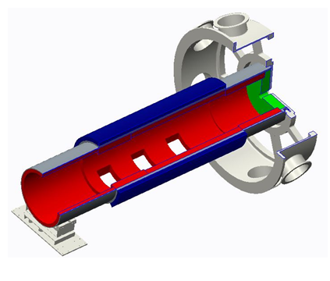
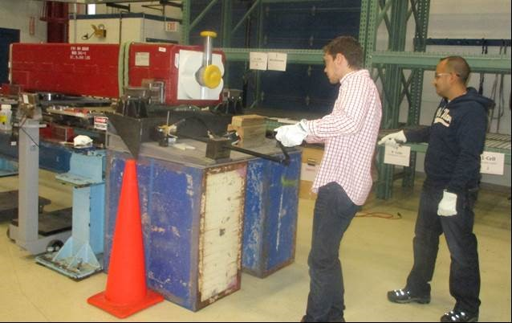
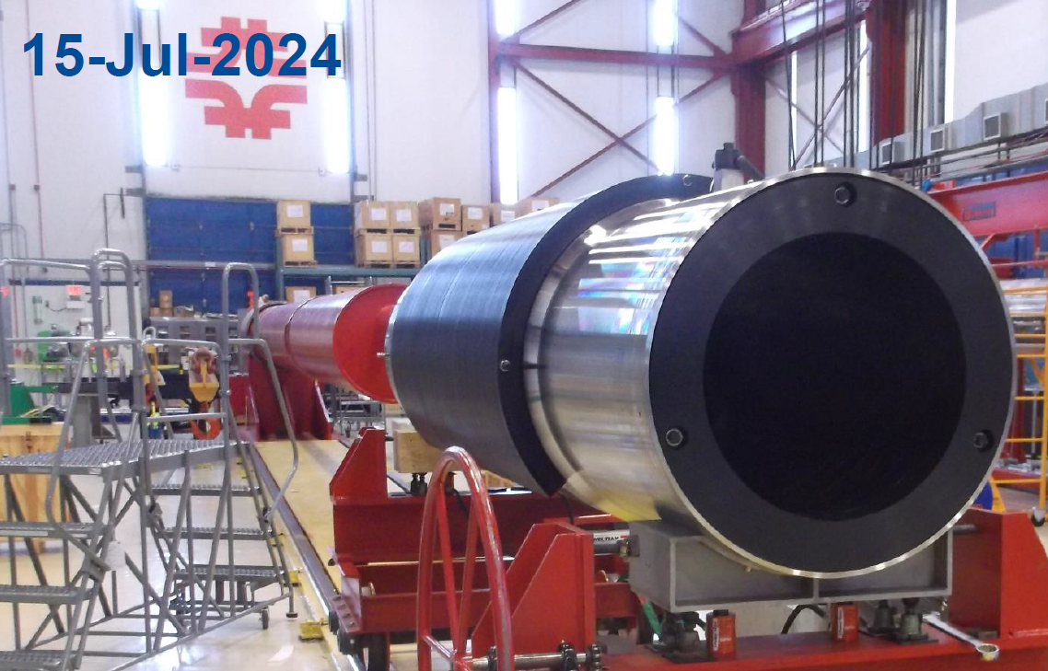
Doing the BIG thing (LM edition)
Design the mu2e muon beam stop
Created test plan
  Huskies roll up sleeves to get it done!
  Completed MS 2016
Balance of requirements:
  Stainless steel thickness
  Weight over 3800 kg (4 tons)
  Supports over 4 meters (13 feet)
  Access holes for vacuum drawdown
  Inserted polyethylene
  Enable support twist and turns
Motion

Slide 12
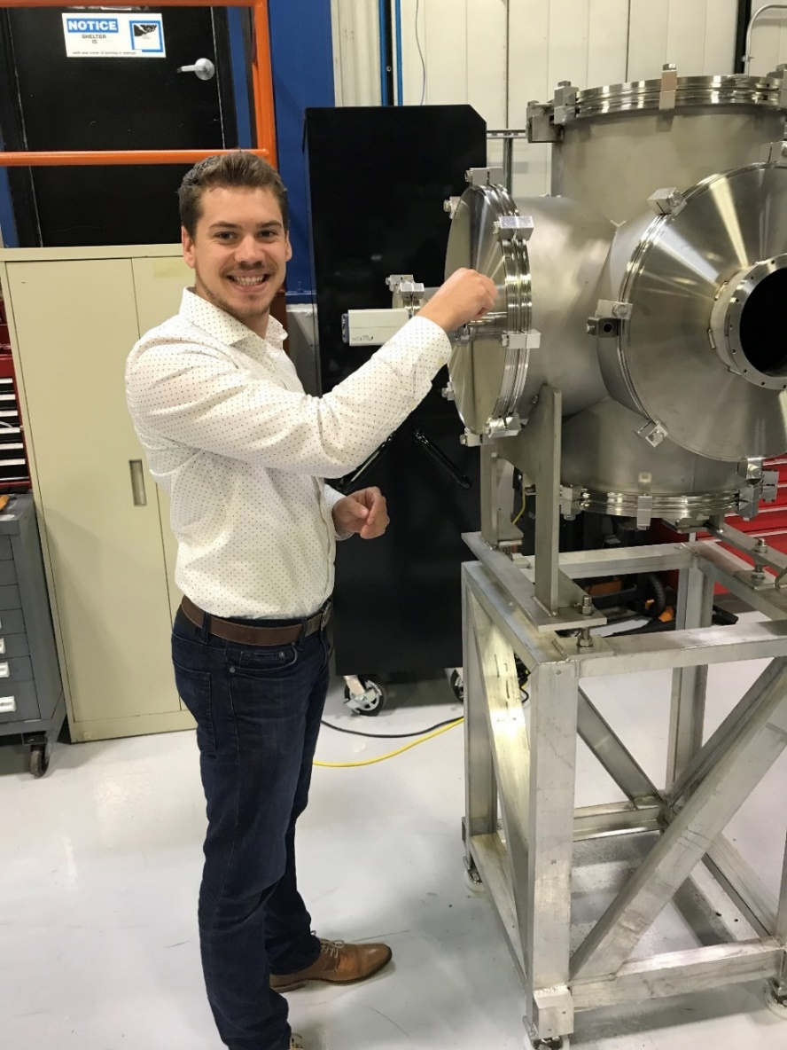
Still a hands-on Huskie
Active Fermilab projects Luke now supports:
  Installation on SuperCDMS
    Super Cryogenic Dark Matter Search
    Located @ SNOLAB, Ontario, CA
  US-HiLumi Accelerator Upgrade Project (AUP)
    Responsible for coldmass instrumentation

Slide 13
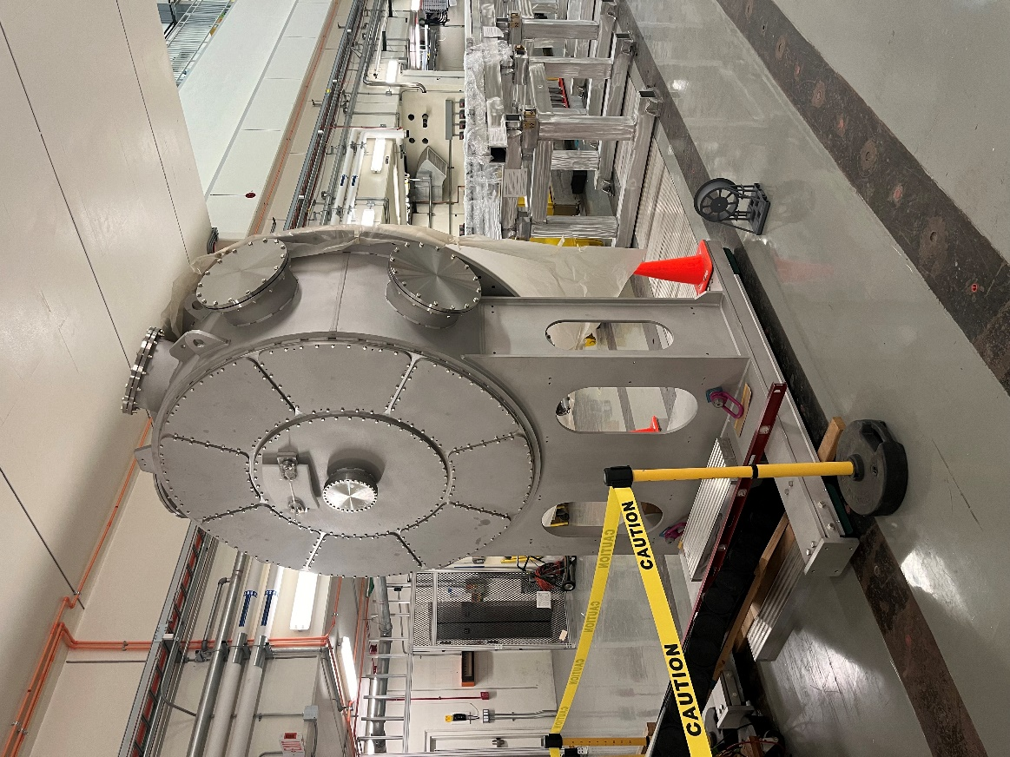
Small things grow
Active Fermilab projects Luke now supports:
  Installation on SuperCDMS
    Super Cryogenic Dark Matter Search
    Located @ SNOLAB, Ontario, CA
  US-HiLumi Accelerator Upgrade Project (AUP)
    Responsible for coldmass instrumentation
  Continues engineering on several systems on mu2e

Slide 14
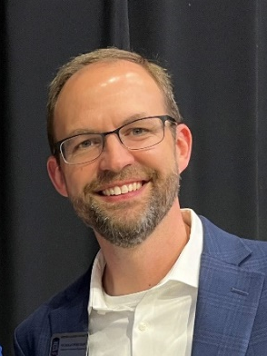
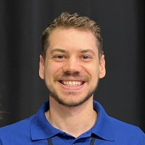
Now … Offering the Opportunity
DOE Grant: Reaching a New Energy Sciences Workforce (RENEW)
Cooperative Research and Development Agreement (CRADA)
Accelerating Underrepresented Engineering Careers through Accelerator Innovations
NIU Capstone Senior Projects
Co-PI: Bart Sharp, Management
$850k support for student training
  8 undergraduate trainees
  3 graduate students
  6 other CEET faculty mentors
  Span MEE, ELE, CS disciplines
Fermilab provides $506k in-kind support of personnel
Confirms partnership for 5-8 real-world design projects
  2024: 6 projects with 19 UG students
  2025: 7 projects with 21 UG students
  2026: open invitation across all divisions
  Introducing more faculty to FNAL & ANL
Commitment of $270k in-kind support

Slide 15
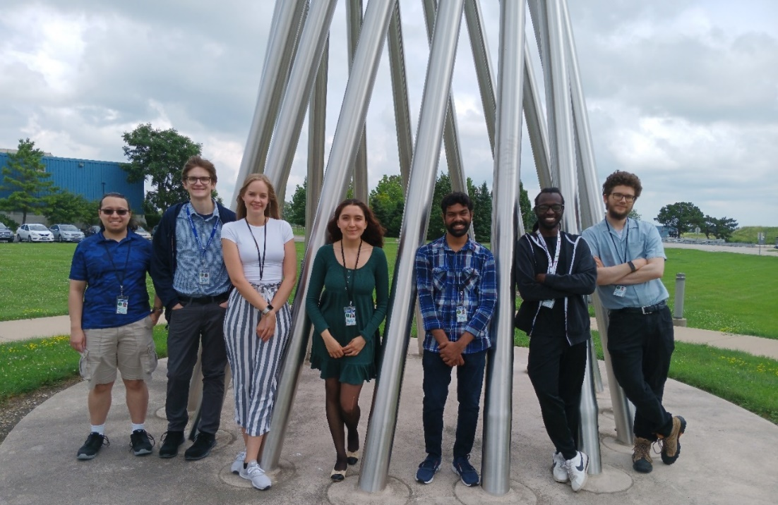
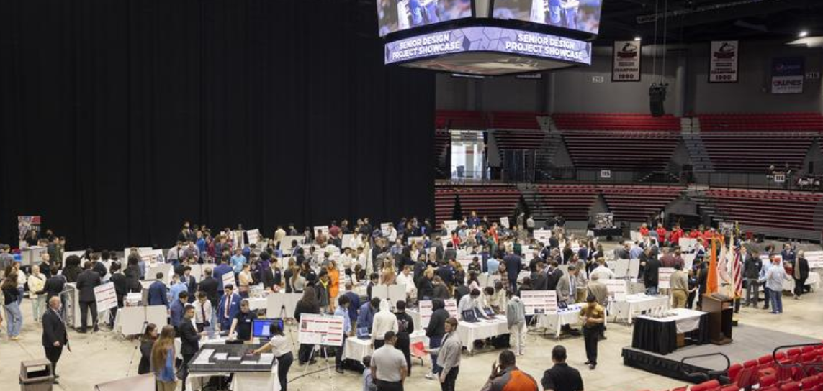

Outcomes: Student success!
2024 CEET Showcase engaging with:
1. Current (and potential!) Sponsors
2. High school students
3. Family and friends
Summer 2024 NIU cohort @ Fermilab

Slide 16






Acknowledgement
NICADD Colleagues
  Jerry Blazey
  Dave Hedin
  Vishnu Zutshi
  Iman Salehinia
Individuals in Divisions of Research and Innovation Partnerships:
  SPA (Dara Little)
  ORCIS (Jim Gable)
  Innovation (Karinne Bredberg)
  ORD (Donna Martin)
Numerous funding agencies:
Too many students to find all of their images on LinkedIn

Slide 17

Question &
Answers
[2]

Slide 18
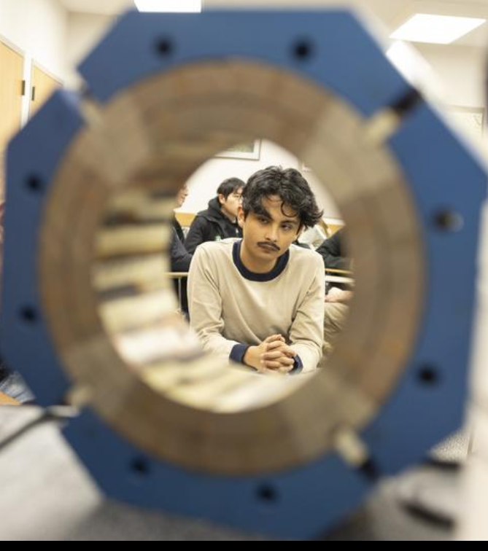
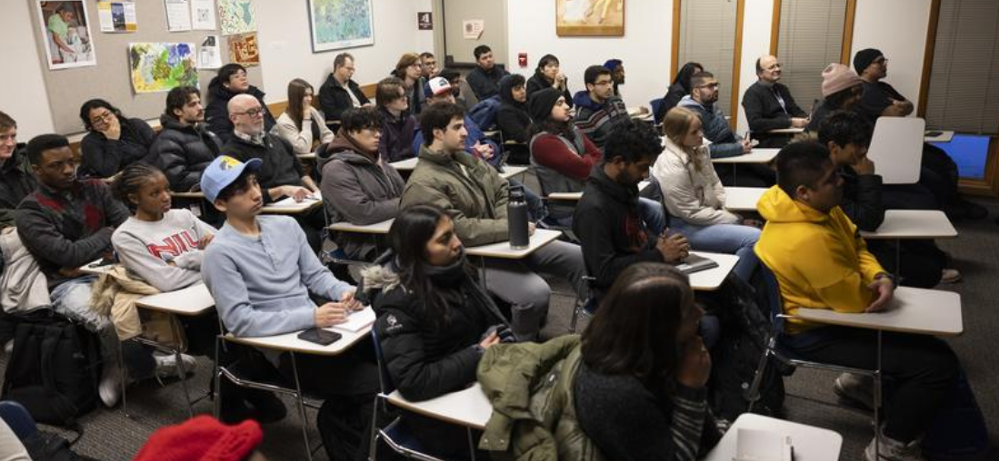
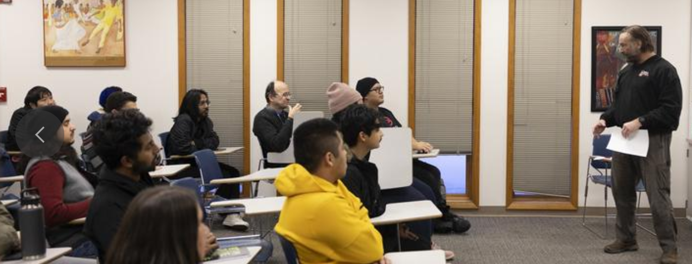
Intro event to mix idea-makers

Slide 19
Bi-annual Idea Mixing for RENEW
G #1
F #3
UG #1
UG #2
UG #3
UG #4
FNAL Idea #1
F #4
FNAL Idea #3
F #5
FNAL Idea #5
F #6
UG #5
G #3
G #2
F #1
F #2
FNAL Idea #2
FNAL Idea #4

Slide 20
Bi-annual Idea Mixing (following iteration)
UG #1
F #1
G #3
G #2
UG #3
FNAL Idea #1
FNAL Idea #3
F #4
FNAL Idea #5
F #6
F #2
UG #2
G #1
FNAL Idea #2
UG #4
FNAL Idea #4
F #5
UG #5
F #3

