Slide 1
Research and Innovation Partnerships
Current Operations Updates

Slide 2
Federal Landscape: Evolving
1/28: OMB freeze memo released
2/7: NIH NOT capping F&A at 15%
1/29: Access to PMS shutdown; FAQ doc released
1/30: OMB memo rescinded
2/3: Federal Judge grants TRO on freeze
2/10: Federal Judge grants TRO on CAP; NIU Party

Slide 3
Federal Funding Portfolio
Source | FY23 | FY22 | FY21 | FY20 | FY19
DoD | 255 | 141 | 547 | 157 | 28
DOE | 3,536 | 3,075 | 2,447 | 2,568 | 2,820
HHS | 1,268 | 1,613 | 1,275 | 930 | 868
NSF | 3,345 | 3,106 | 2,741 | 2,112 | 2,500
Other | 2,445 | 1,905 | 2,070 | 2,263 | 2,394

Slide 4
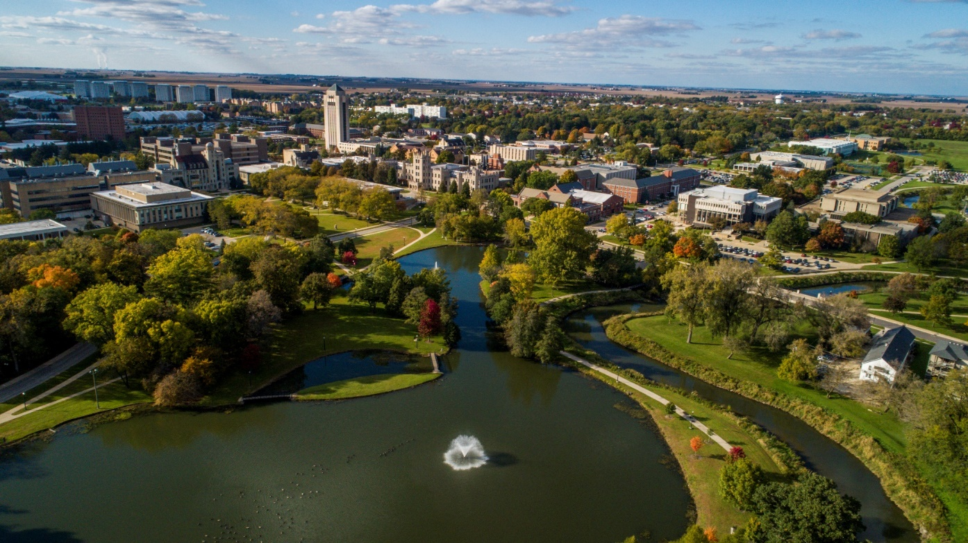
Indirect Costs
Facilities and Administrative costs, aka indirect costs, are those expenditures or costs that are not readily identifiable with a particular project or activity, but are necessary to the general operation of the university and the conduct of its activities.
Type | Rate
Organized Research | 52%
Instruction | 52%
Other Sponsored Activities | 37%
Off-Campus | 26%

Slide 5
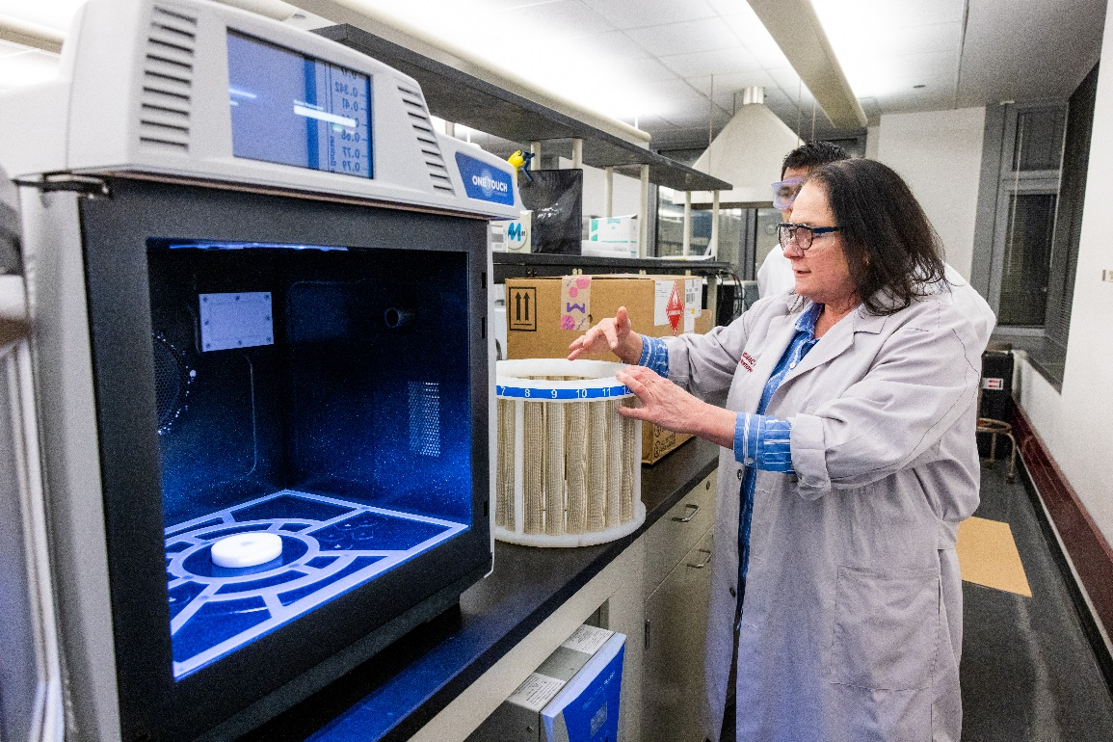
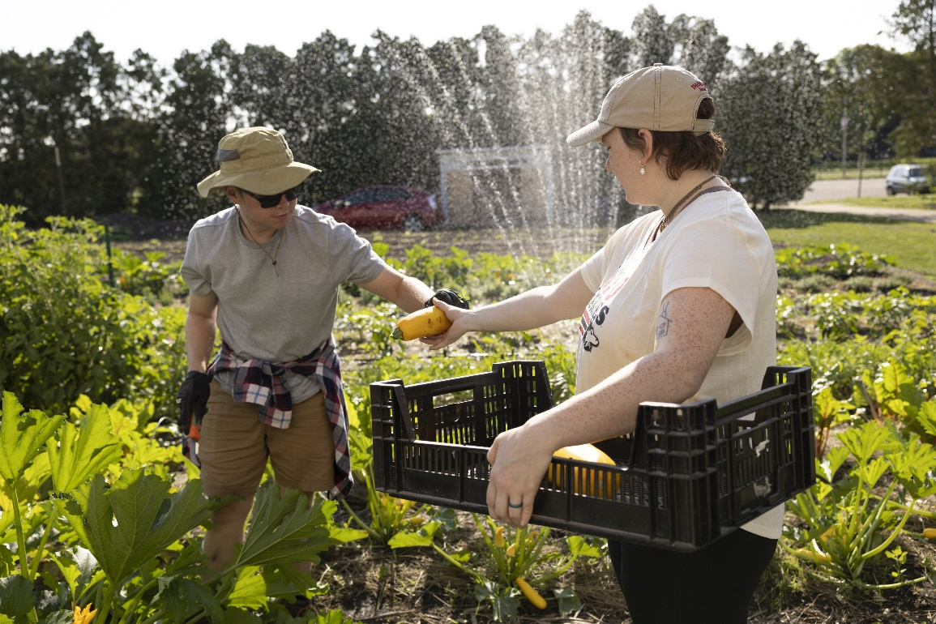
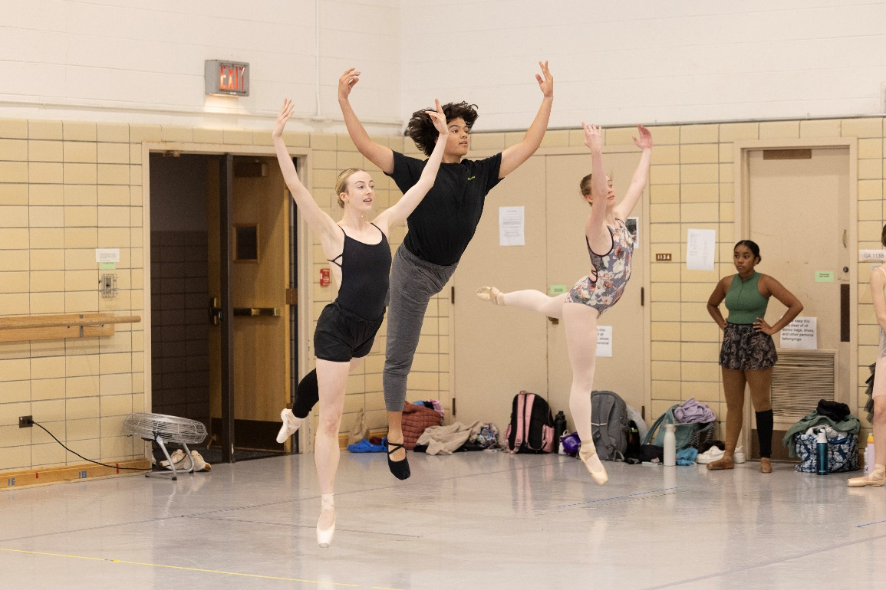


Proactive Measures
Identify all programs funding sources
Connect with PIs to learn about current status and challenges
Develop and Expand Partnerships (Internal and External)
Nurture Entrepreneurial Mindset
Improve Operational Effectiveness
Increase Brand Awareness (Internal and External)

Slide 6
Proactive Measures
Partnering with Advancement, Academic Affairs, and OERD to help PIs identify diversified funding streams
Employing a rapid research development methodologyre Entrepreneurial Mindset
Improve Operational Effectiveness
Increase Brand Awareness (Internal and External)

Slide 7


Proactive Measures
Maintain an up-to-date website with current guidance for federal awardees
Improve Operational Effectiveness
Increase Brand Awareness (Internal and External)

Slide 8




Proactive Measures
Working with senior leadership to identify priorities:
  Centrality of students, centrality of mission, grant status, impact on campus, availability of funding, program track record
Increase Brand Awareness (Internal and External)

Slide 9




Proactive Measures
Working with partners from around the country to monitor the situation, contribute to actions when needed, and continue to pursue a broad base of support for our faculty in their research, scholarship and creative activities. (Internal and External)

Slide 10





Thank you
Questions

