Slide 1
HRS Updates to Board of Trustees
Division of Human Resource Services
Thursday, May 8, 2025

Slide 2
What we’ll cover today
Introduction of CHRO
About HRS
University Employment Data
Compensation philosophy and framework
What is a market analysis?
Overview of market analysis (university-wide)
Summary
Questions & Answers

Slide 3

Introduction of CHRO
NIU Alumnus
Rockford native, moved to DeKalb for NIU.
Previous work experience in higher education:
  UW-La Crosse
  North Central College
  Kishwaukee College
John Acardo
Chief Human Resources Officer
MBA, SPHR, SHRM-SCP

Slide 4

About HRS
HRS has enhanced services to align with university goals and institutional needs.
Focused on developing strategic partnerships with departments to align university values and goals.
Recognized as a Great College to Work For
Strengthened meetings with supervisors to once a month, during semesters.
Enhanced data reporting and analysis.
Developed and implemented a compensation philosophy and framework for staff.

Slide 5
About HRS
HRS is focused on aligning employment activity with the university’s mission and goals. Specifically:
Goal 1B- Foster an environment of meaningful engagement, mutual respect and Huskie pride.
Goal 6A- Ensure Fiscal Sustainability and Achieve a Balanced Budget by FY26.

Slide 6
About HRS: Looking Ahead
Implementation of Time and Labor automation.
Finalize automation of all forms.
Introduce DocuSign for contracts and appointments.
Further enhance and simplify business process workflows.
Development of Employee Training Portal.
Enhanced communication through the use of a ticketing system.

Slide 7
University Employment Data

Slide 8
Headcount Data

Slide 9
Headcount Data
SPS to Civil Service Conversion
COVID Years Decline

Slide 10
Compensation Framework

Slide 11
Compensation philosophy and framework
Our compensation philosophy reflects our dedication to our employees’ success. Investing in our workforce ultimately benefits our students and the broader community. As we move forward, we remain committed to continuous improvement and ensuring that our compensation practices align with our university’s purpose and values.
Developed by shared leadership and shared governance groups in 2024
Guides the framework for decision-making on compensation matters.
Read more: https://www.niu.edu/hrs/departments-managers/compensation/philosophy.shtml

Slide 12
What is a market analysis?
Data-informed Market Analysis
Civil Service Salary Survey
CUPA Market Data
External Market (5,000+ organizations, 300 in higher ed)
Industry-specific Market Data
NIU utilizes a tool called PayFactors to review market information to inform decisions.
Combines multiple sources of market information to inform analysis.
Aligned with best practices, the university targets 92% of the market median.

Slide 13
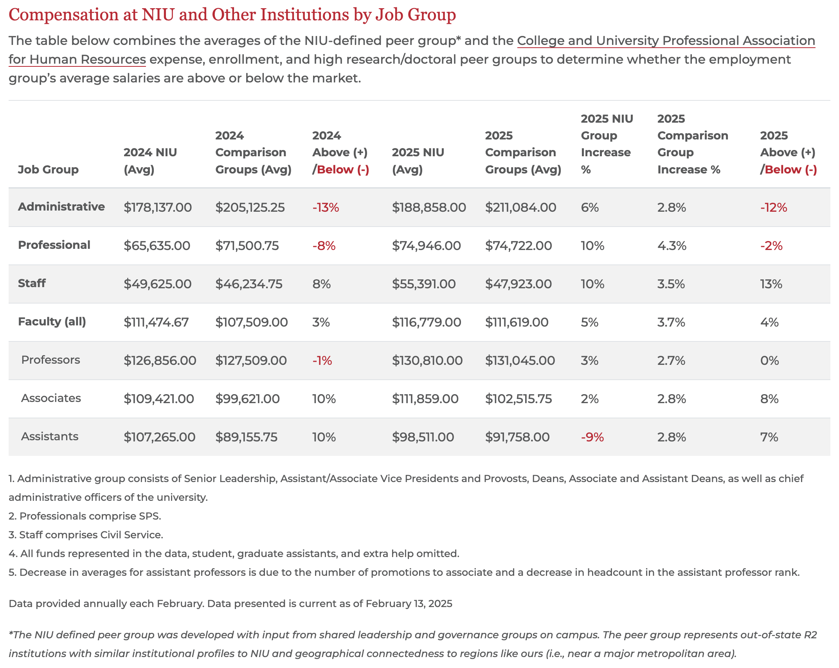
Overview of market analysis (university-wide)
The university has recognized improvement in the market competitiveness of our average salaries from 2024 to 2025.
More information: https://www.niu.edu/hrs/departments-managers/compensation/comparative-analysis.shtml

Slide 14
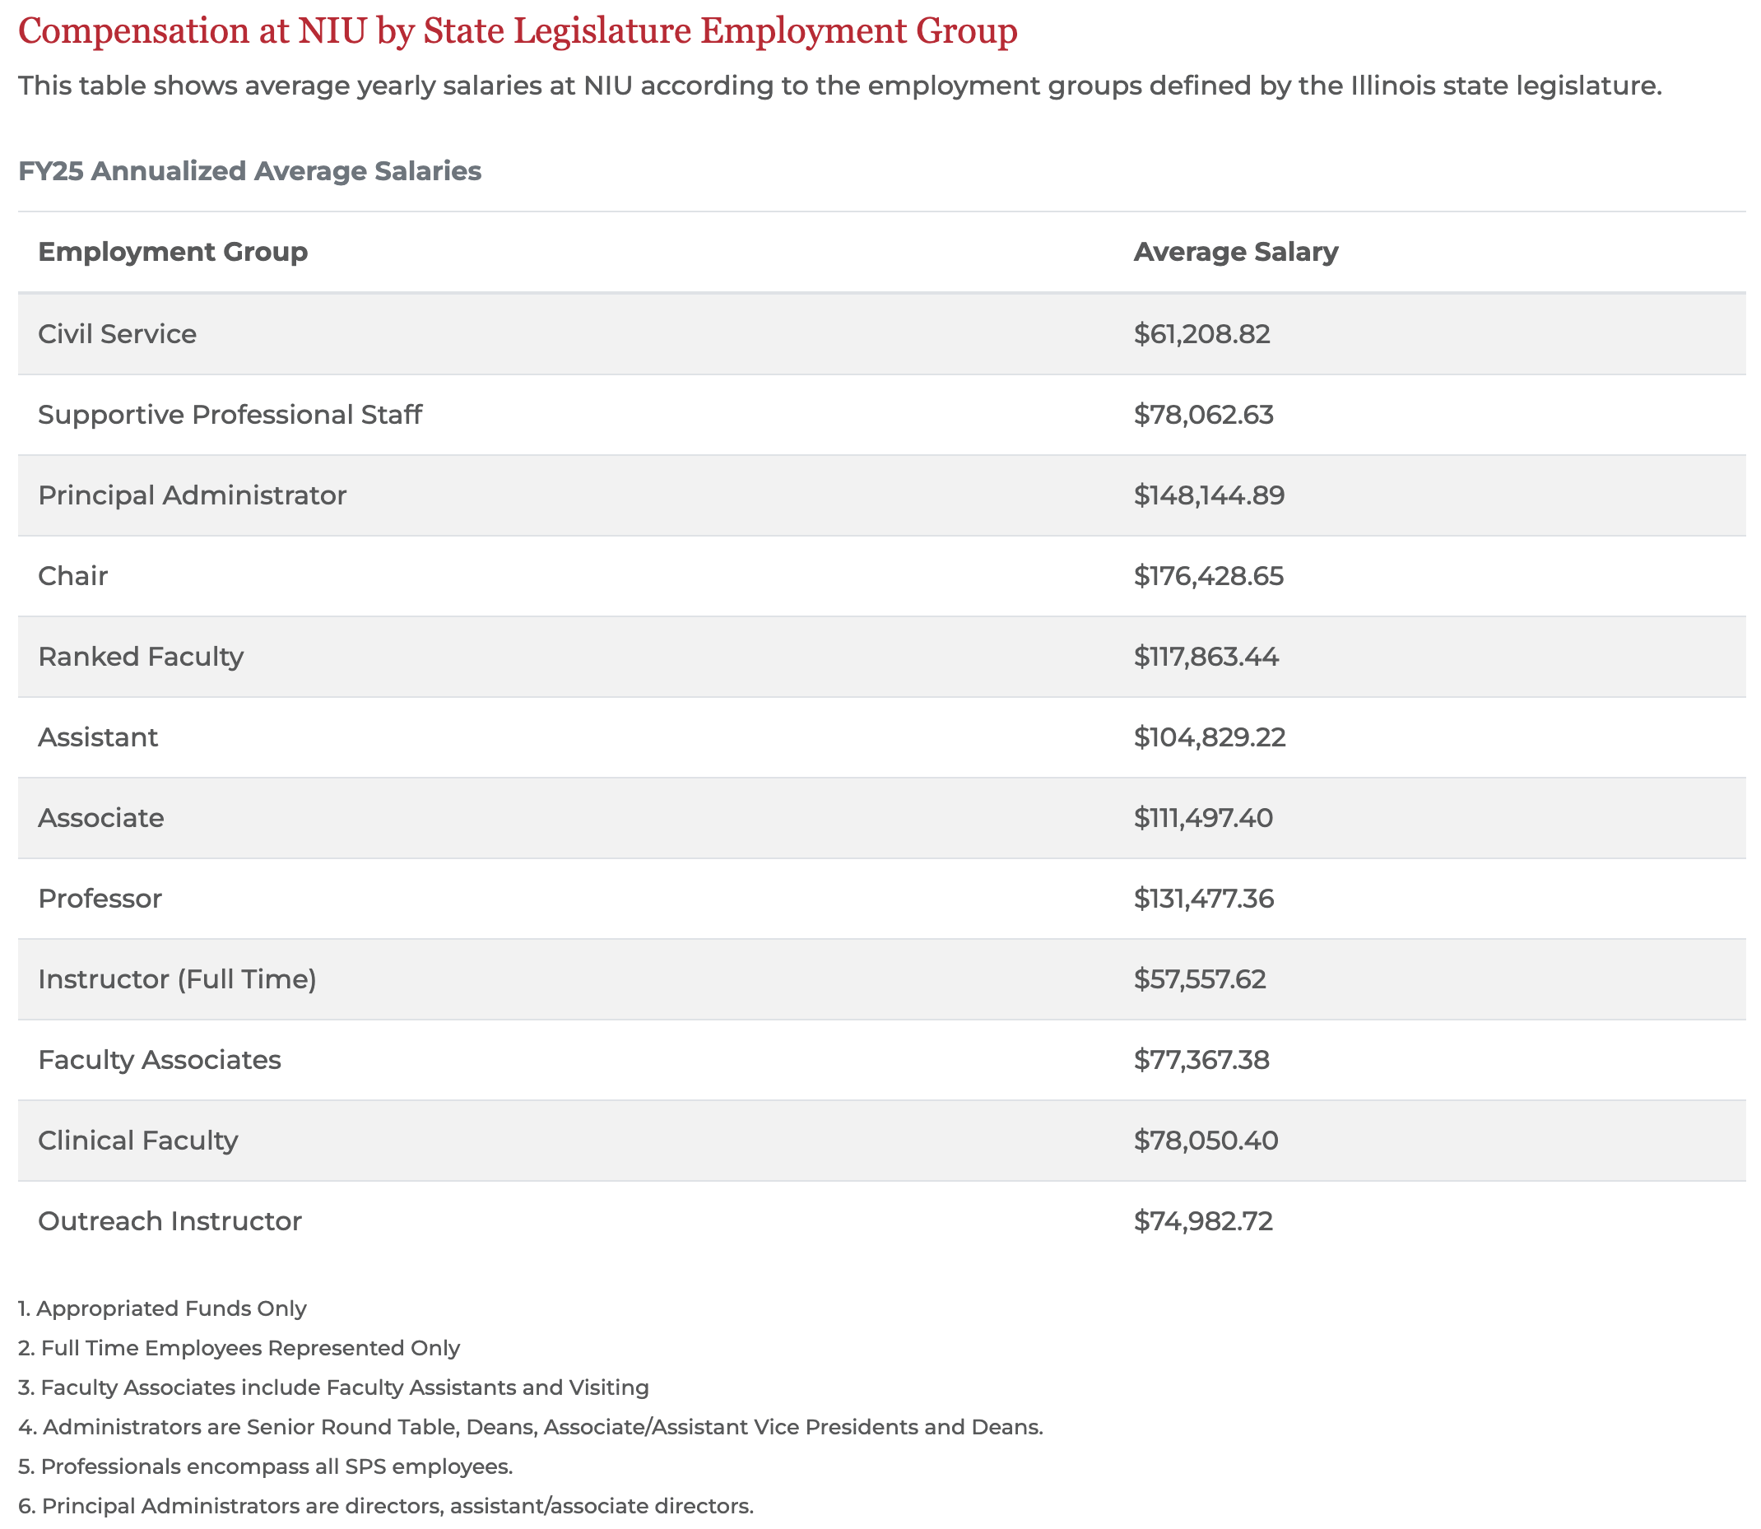
Overview of market analysis (university-wide)
Another way to look at data is through what we report to the legislature and on appropriated funds.
More information: https://www.niu.edu/hrs/departments-managers/compensation/comparative-analysis.shtml

Slide 15
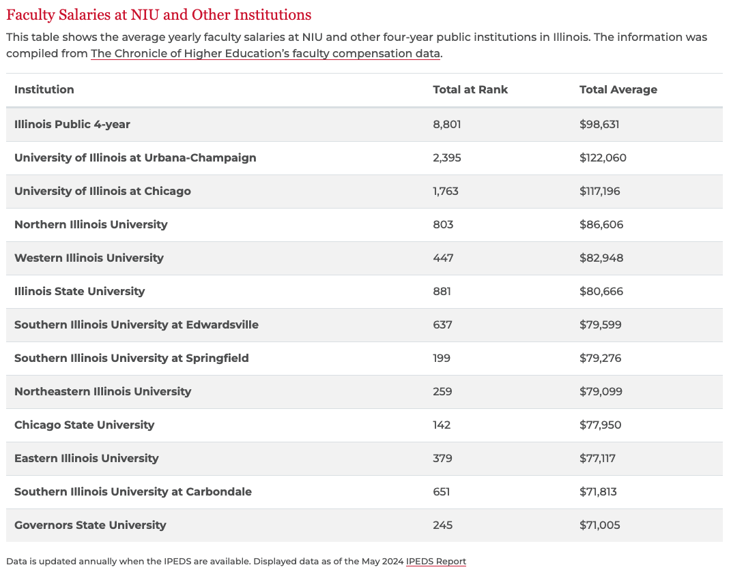
Faculty Compensation

Slide 16
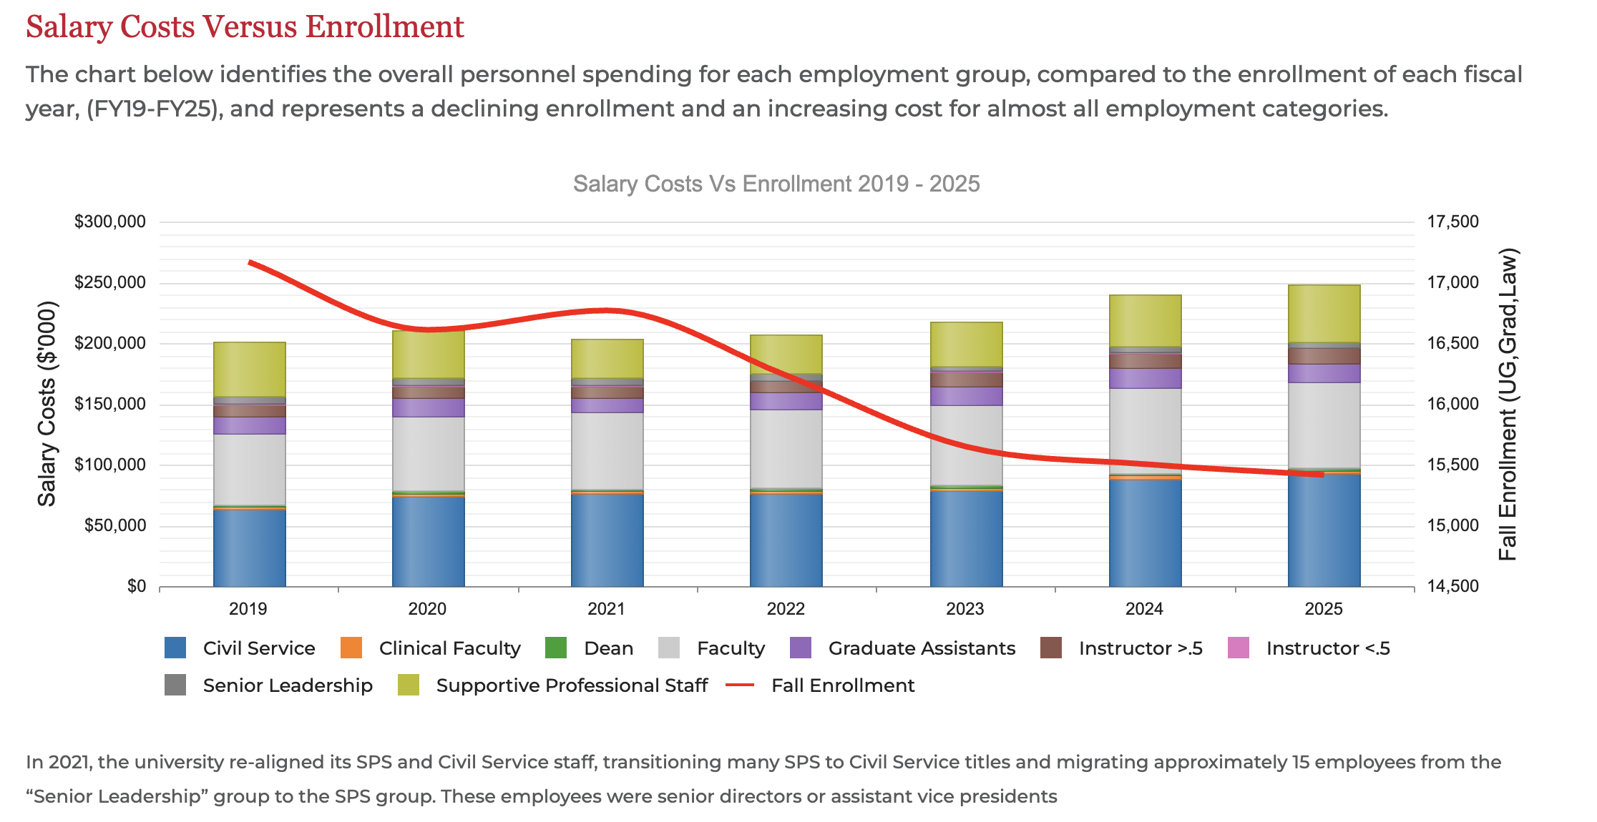
Overview of market analysis (university-wide)
More information: https://www.niu.edu/hrs/departments-managers/compensation/comparative-analysis.shtml

Slide 17
Summary
HRS is committed to being a strategic partner in developing programs aligned with the university's mission and goals.
NIU is dedicated to offering competitive wages through continuous market analysis, ensuring our compensation packages remain attractive and fair.
By aligning total rewards, including all cash and non-cash incentives, with our mission and values, we foster a supportive and motivating environment for our employees.

Slide 18

Thank you!
Questions & Answers

