Slide 1
Foundation Update for the NIU Board of Trustees
Catherine Squires
March 27, 2025

Slide 2
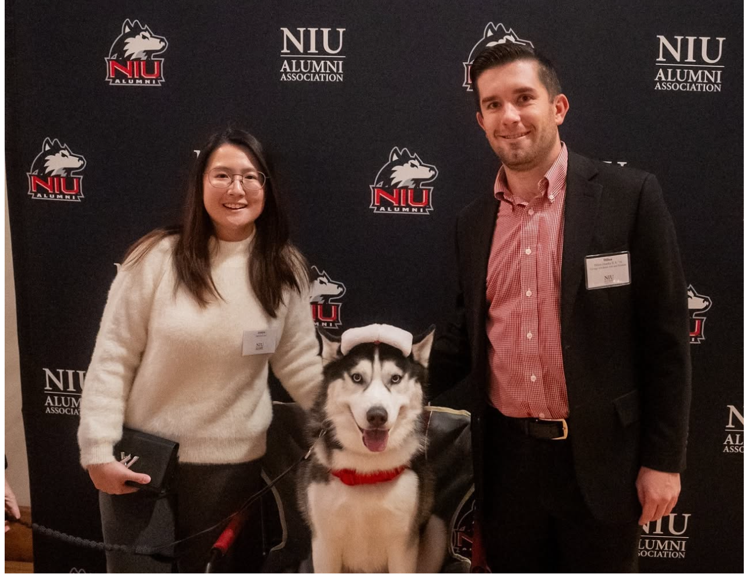
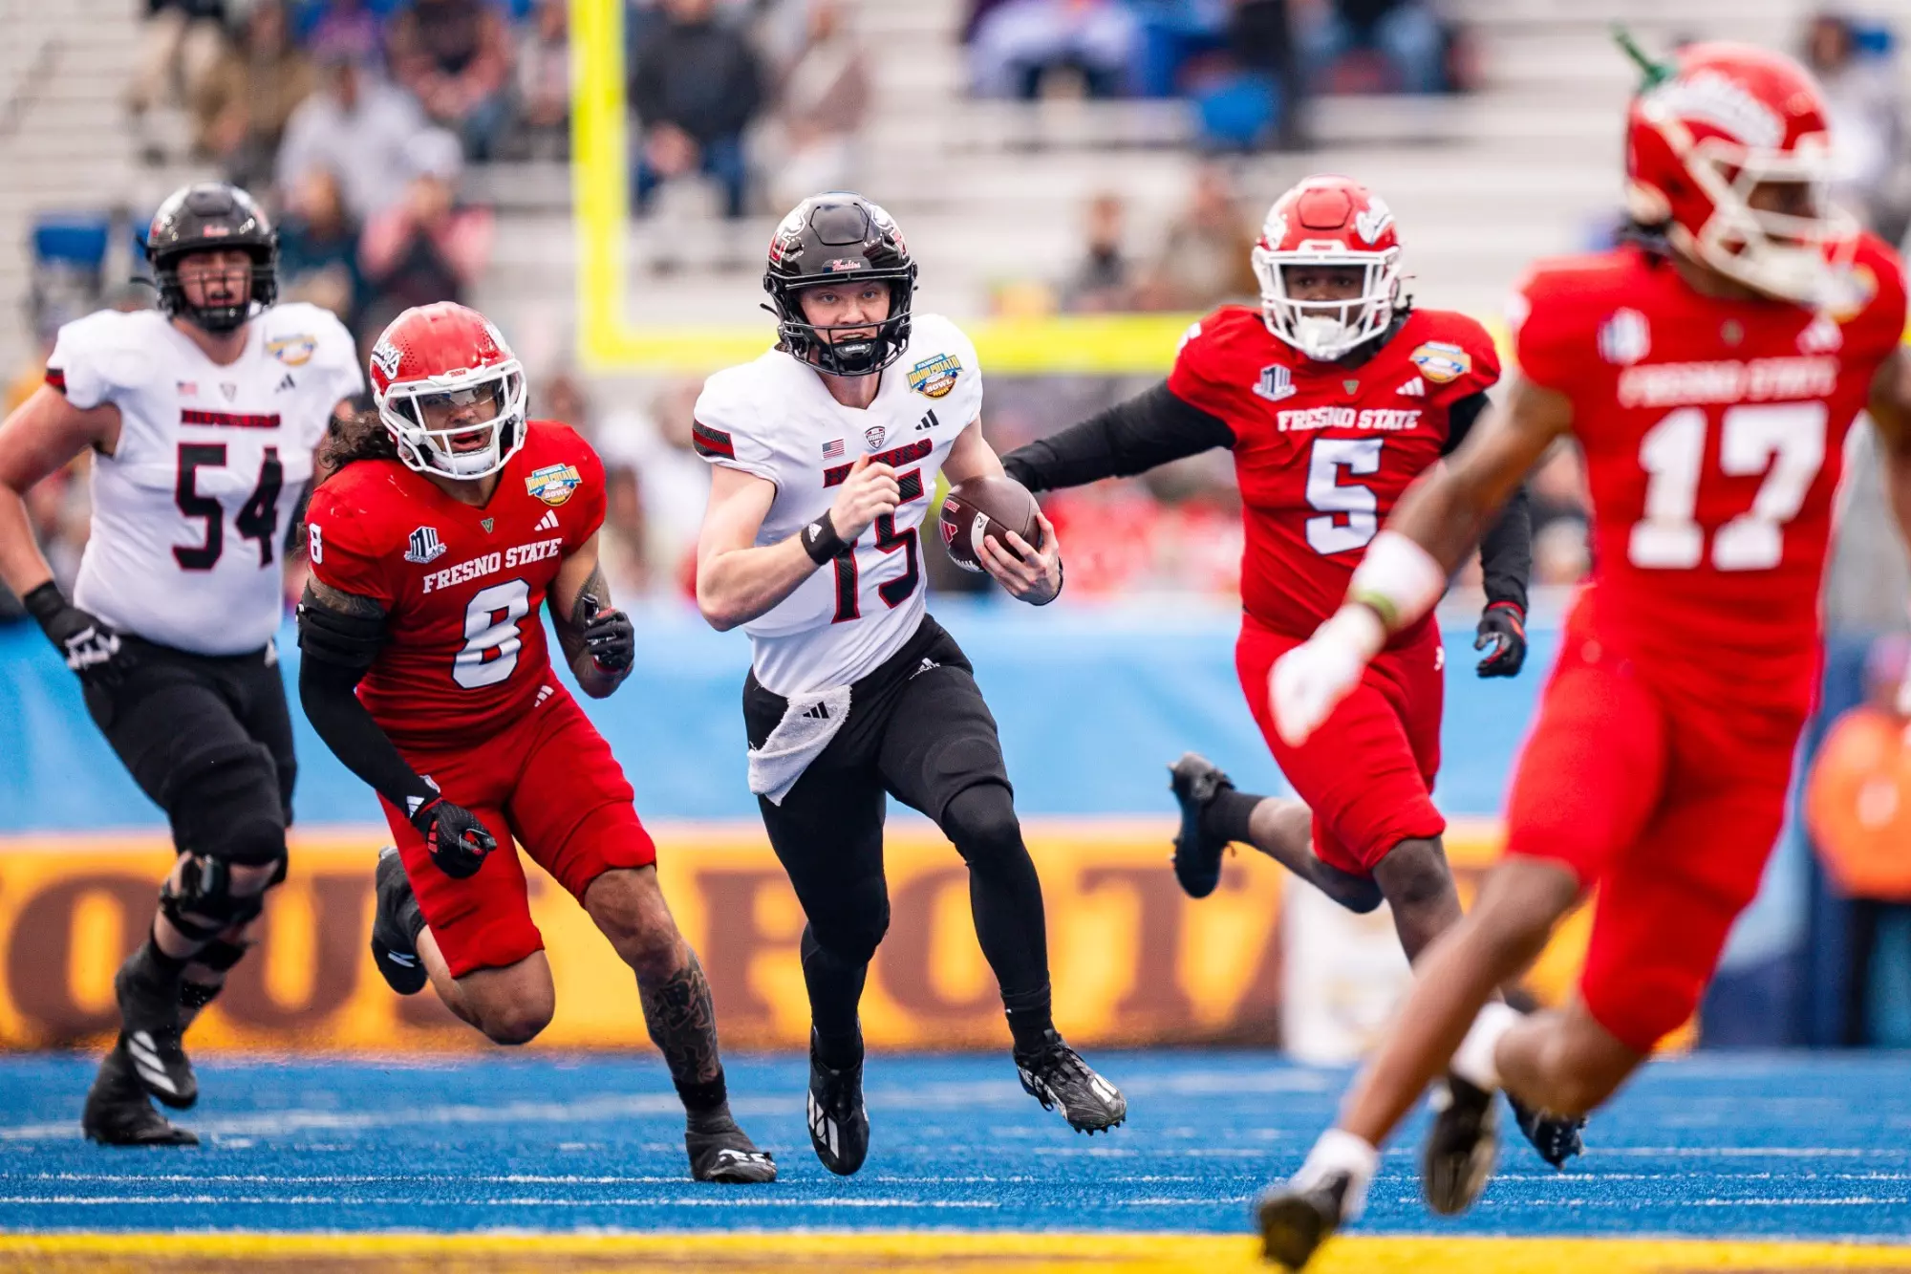

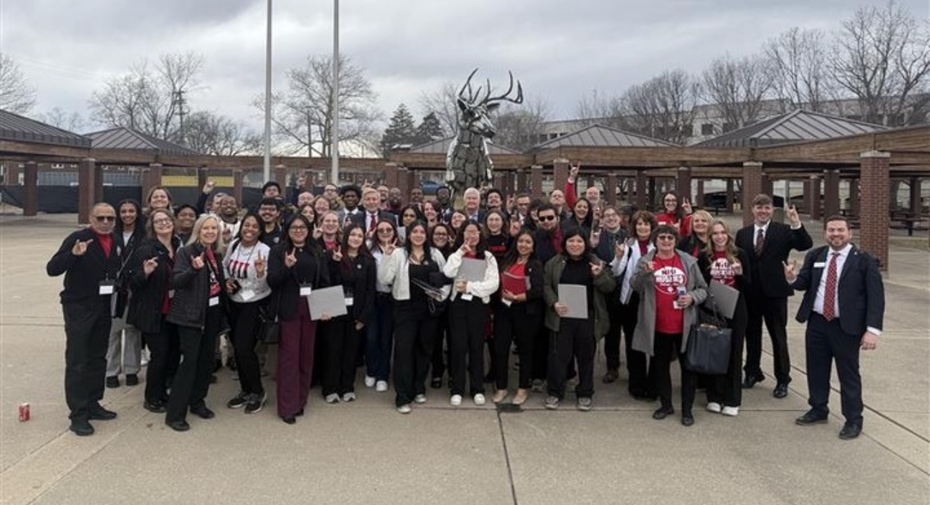
Foundation and Alumni Association Updates and Activities
Events
  Alumni Holiday Reception
  Boise Idaho Potato Bowl
  Florida Trip Events:
    Boca Raton
    Bonita Bay
    Sarasota
    Fort Lauderdale
  Arizona Trip
  Advocacy Day

Slide 3
Philanthropy Report FY25Q2 (Ended December 31, 2024)
$60.00M
$32.00M
Millions
Millions
$53.1
88.5% of goal
$13.00M
$13.00M
$5.92M
18.5% of goal
$2.22M
17.0% of goal
$17.9M
137.7% of goal

Slide 4
Philanthropy Report FYTD (Fiscal Year 2025 to date)
$60.00M
$32.00M
Millions
Millions
$57.4M
95.7% of goal
$13.00M
$13.00M
$5.92M
18.5% of goal
$2.22M
17.0% of goal
$19.7M
151.5% of goal

Slide 5
Campaign Timeline
LEADERSHIP/QUIET PHASE
PUBLIC PHASE
FY22
FY23
FY24
FY25
FY26
FY27
FY28
FY29
FY30
EXTENSION or TRANSITION
Implementation of recommendations
Case development begins
Campaign begins
Cultivation and solicitation continues
Prep for launch
Continuously Energizing
Our Communities
Cultivating donors with strategic solicitations
Celebrating Campaign donors
Fueling the external MarCom plan
Monitoring and sharing progress to goal
Prospect research / Gift Table
Case refinement with internal stakeholders
Marquee project and unit case for support development
Campaign Cabinet named
Campaign anthem developed and revealed
Cultivation of key / lead donors begins in earnest
Marts & Lundy Study
Campaign Fundraising Activity through 3/12/25
$161.2M

Slide 6
Overall Activity Growth Comparison
FY19-FY21 and FY22-FY24
Campaign Activity
Overall Activity Growth
  63.8%, from $48M to $78.7M
Major Giving Activity Growth
  73.7% from $30.2M to $52.5M
PRE-CAMPAIGN PHASE
LEADERSHIP PHASE
FY 25 YEAR-TO-DATE
Gifts and Pledges | FY 19 – 21 Gift Count | FY 19 – 21 Activity | FY 22 – 24 Gift Count | FY 22 – 24 Activity | Amount Increase | % Gift Count Increase | FY25 Gift Count | FY25 Activity
$1M+ | 5 | $11.5M | 13 | $27.8M | +$16.3M | 160% | 4 | $45.2M
$500K - $999K | 9 | $5.8M | 15 | $9.3M | +$3.5M | 66.7% | 2 | $1.5M
$100K - $249K | 29 | $4.3M | 66 | $9.7M | +$5.4M | 127.6% | 16 | $2.0M
$50K - $99.9K | 55 | $3.4M | 84 | $5.0M | +$1.6M | 52.7% | 22 | $1.3M
$25K - $49.9K | 67 | $1.8M | 96 | $3.0M | +$1.2M | 43.3% | 37 | $1.1M
$10K - $24.9K | 209 | $2.7M | 359 | $4.6M | +$1.9M | 71.8% | 97 | $1.2M

Slide 7
Northern Fund Giving Growth Comparison
FY19-FY21 and FY22-FY24
Northern Fund Giving Growth
PRE-CAMPAIGN PHASE
LEADERSHIP PHASE
FY 25
YEAR-TO-DATE
 | FY 19 – 21 Actual | FY 22 – 24 Actual | Amount Increase | % Gift Count Increase | FY 25 Activity
Total Northern Fund Activity | $1M | $4.4M | +$3.4M | 319.8% | $3.0M
Major Gifts | $23.7K | $2.8M | +$2.7M | > 500% | $2.7M
Annual Giving | $1M | $1.6M | +$600K | 56.6% | $332K
Annual Fund Giving Growth
PRE-CAMPAIGN PHASE
LEADERSHIP PHASE
FY 25
YEAR-TO-DATE
 | FY 19 – 21 Actual | FY 22 – 24 Actual | % Gift Count Increase | Amount Increase | % Gift Count Increase | FY 25 Activity
Total Annual Giving Activity | $17.8M | $26.1M | 47% | +$8.3M | 47% | $4.9M

Slide 8
Endowment Giving Growth Comparison
FY19-FY21 and FY22-FY24
Endowment Giving Growth
Giving toward endowment has grown at the major gift level
Additional growth is needed at the principal gift level and current results on FY25 demonstrate this on the gift table
PRE-CAMPAIGN PHASE
LEADERSHIP PHASE
FY 25 YEAR-TO-DATE
 | FY 19 – 21 Gift Count | FY 19 – 21 Activity | FY 22 – 24 Gift Count | FY 22 – 24 Activity | Amount Increase | % Gift Count Increase | FY25 Gift Count | FY25 Activity
$1M + | 1 | $1.0M | 2 | $2.1M | +$1.1M | 110% | 3 | $17.8M
$500K - $999K | 1 | $501K | 3 | $1.5M | +$1.0M | 200%
$100K - $249K | 10 | $1.6M | 18 | $3.0M | +$1.4M | 87% | 3 | $350K
$50K - $99K | 10 | $588K | 22 | $1.3M | +$754K | 121% | 7 | $440K

Slide 9

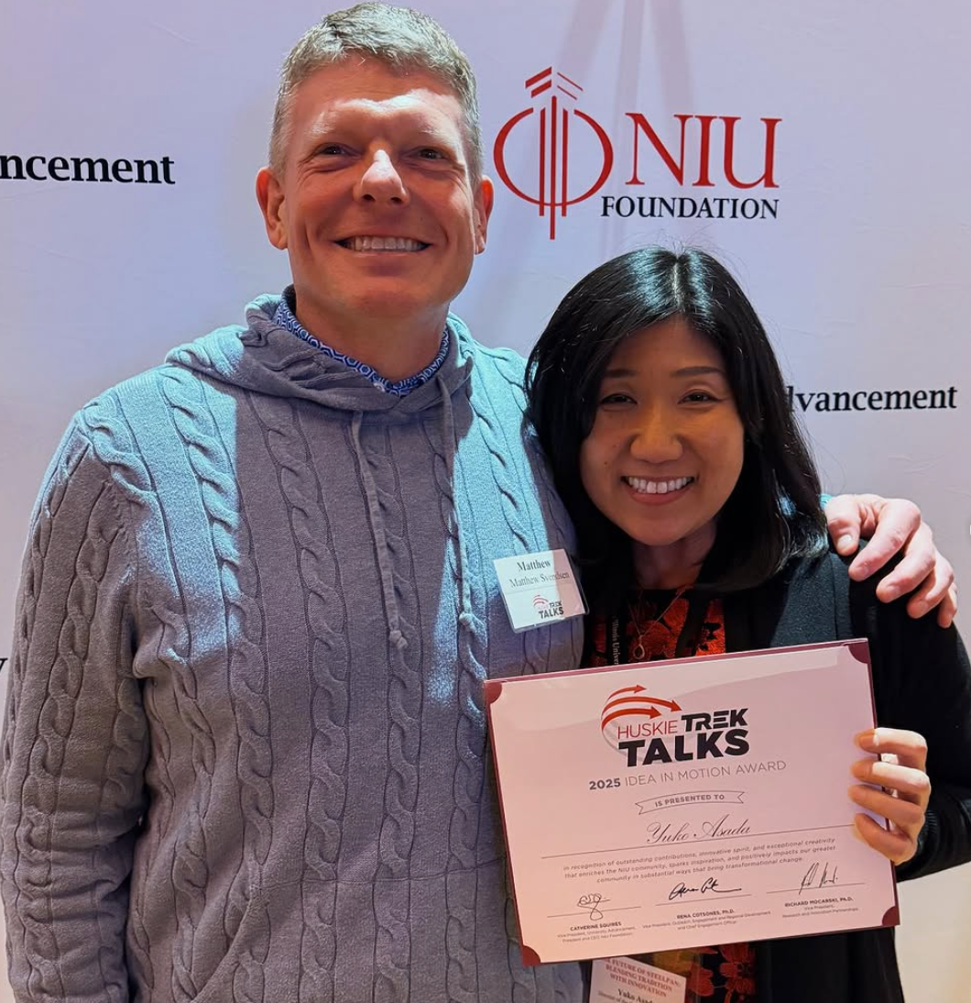
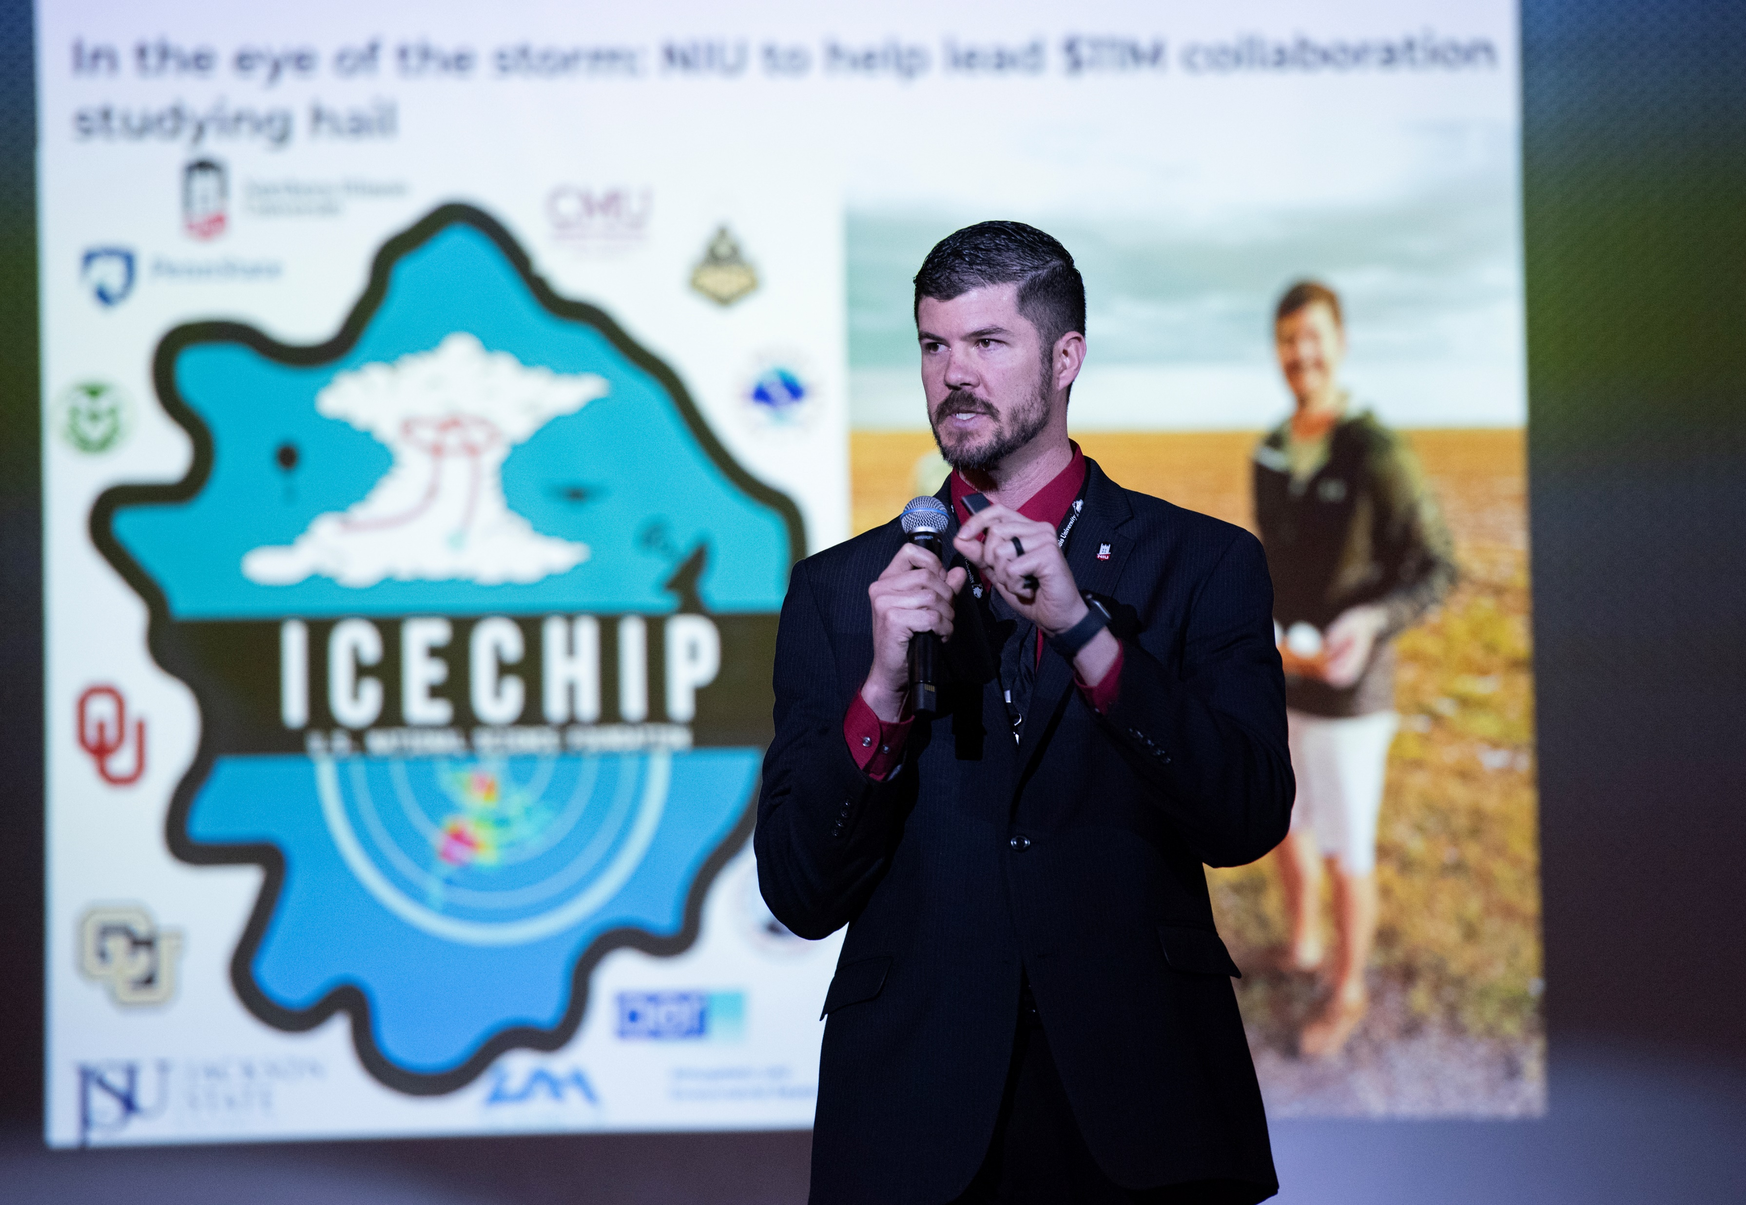
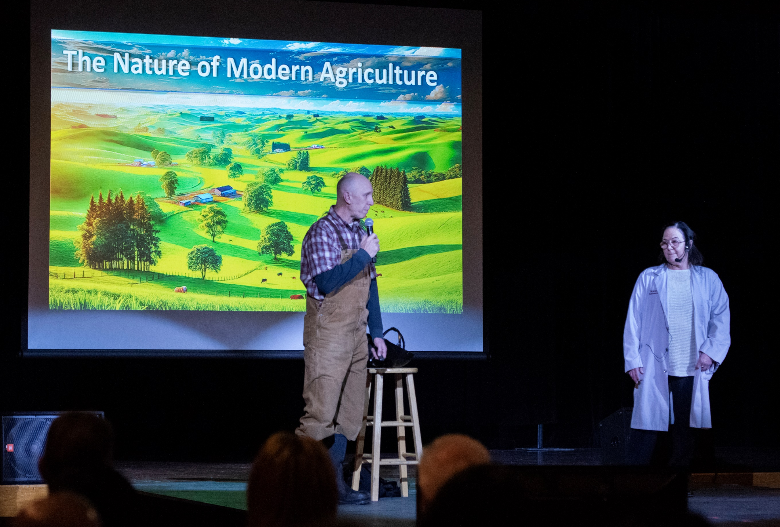
Huskie Trek Talks
More than 150 people joined us for ten faculty and student presentations showcasing innovation and discovery happening across campus.
Drives extended gift conversations with major donors
  Yuko Asada’s work on steelpan education and creation
Provided $65K in grants + one graduate assistantship
Presentations from COB, CEET, CHHS, CLAS and CVPA

Slide 10
Huskie Frontier Teams
Response to uncertainty and change at the federal funding level
Outgrowth of the Strategic Development Team
Collaboration of RIPS, Advancement, OERD and Academic Affairs
Two pathways
Short term objectives – to address emergent needs
Longer term objectives – to build institutional capacity
Activities update
Launch events this week!

Slide 11
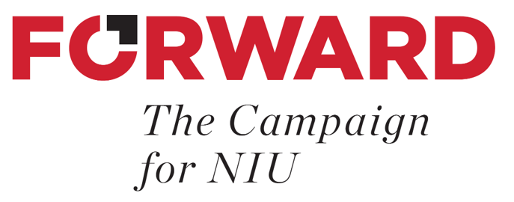
Campaign Launch Event
Saturday, June 14, 2025
NIU Convocation Center
A high-impact, memorable event that engages and inspires donors to contribute to the university’s future and achieves the following objectives:
Launches the campaign: Publicly announce the campaign’s goals, vision, and strategic initiatives.
Supercharges engagement and connection: Strengthen the relationship between NIU and its donor community.
Inspires giving: Highlight the university’s vision, progress, and the potential impact of donor contributions.
Recognizes donor contributions: Celebrate the achievements of donors and encourage further investments.
Creates momentum: Generate excitement and enthusiasm around the fundraising campaign to encourage further giving.

