Slide 1
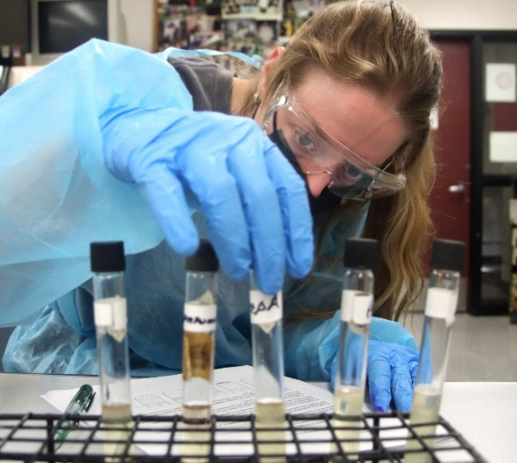
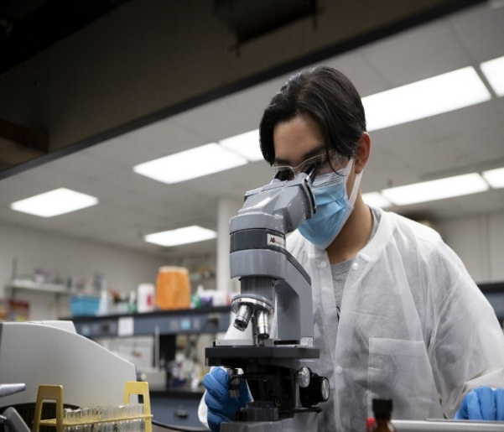

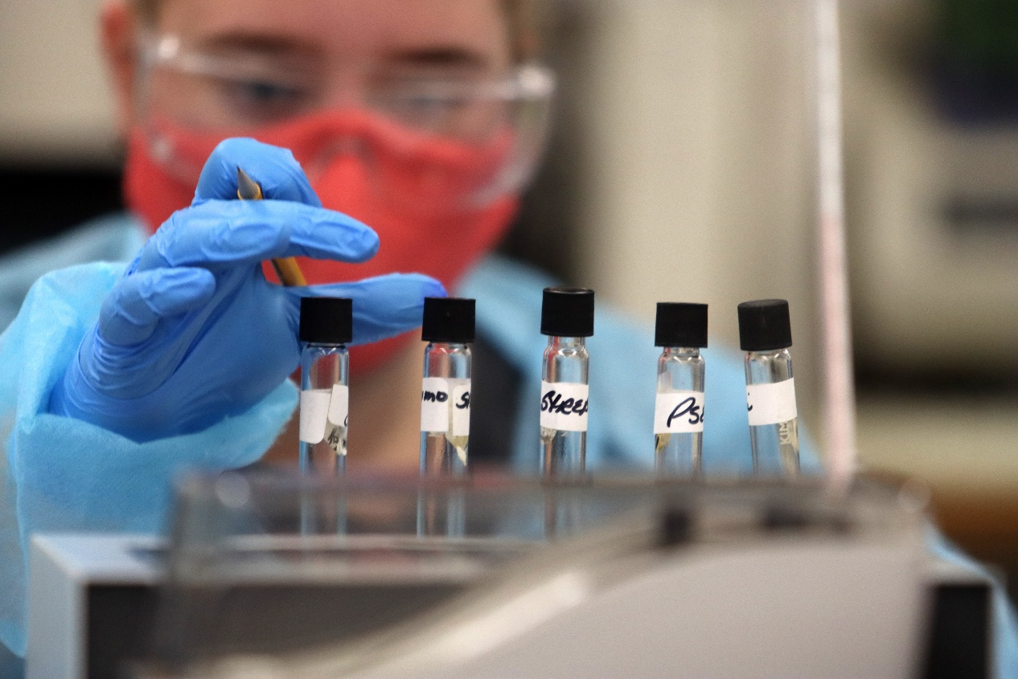
Medical
Laboratory
Sciences:
Hands-on Learning
Board of Trustees Presentation
June 12, 2025

Slide 2
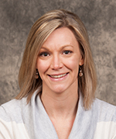
Amanda Voelker
Clinical Coordinator for MLS
Joined NIU in 2015.
Teaches immunohematology lecture and lab.
Earned an A.S., B.S and Master of Public Health.
Notes:
Thank you for the opportunity to highlight our program and our students today. I am Amanda Voelker, the clinical coordinator for the Medical Laboratory Sciences program at NIU.
WHY NIU?
I enjoy being a mentor to students and seeing them develop as they connect the dots between theory and application.
Before we dive into our presentation about the role that hands-on learning plays in preparing our students for future careers, I want to give you a brief overview about what Medical Laboratory Sciences (MLS) is and about and the important role we play in the health care team.

Slide 3
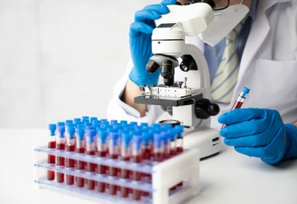


Medical Laboratory Scientists
What we do:
Provide scientific analysis of blood and body fluids.
Skills we have:
Sharp analytical skills, working calmly and
quickly under pressure.
Where we work:
Hospitals, clinics, physician’s office labs and
reference laboratories.
Why we matter:
Laboratory results inform of clinical decision making.
Notes:
What we do: Vital health care team members who provide scientific analysis of blood and body fluids.
If you have ever had blood or fluids analyzed – it’s MLS who are working behind the scenes.
MLS degree holders also work in public health roles, forensics, research, sales and marketing and education.

Slide 4
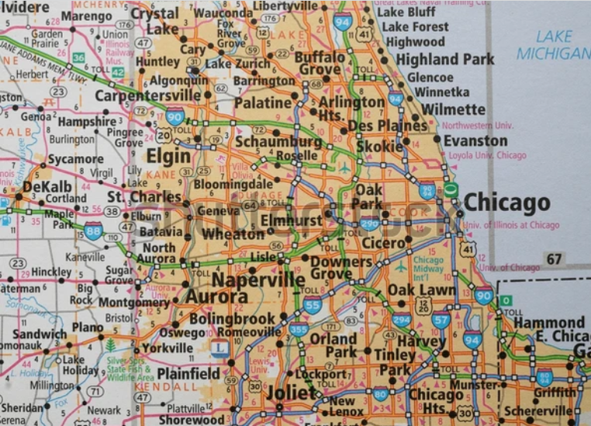

Why MLS at NIU?
Our bachelor’s degree program is accredited by the National Accrediting Agency for Clinical Sciences.
Location, location, location!
Notes:
The NIU B.S. in Medical Laboratory Sciences is accredited by National Accrediting Agency for Clinical Sciences (NAACLS)
Proximity to Chicago and surrounding communities makes NIU an ideal choice.
Tell about the MLS program at NIU
The last two semesters in our program includes a clinical placement.
Why is this placement so important for career development
NIU offers an ideal location for our students to gain real-world experiences through clinical placements – proximity to Chicago and suburban health centers
We help find sites for students – some programs students have to find their own placement
Program has an excellent reputation among alumni and affiliates.
Now I’d like to introduce Wendy Lozano, a May 2025 graduate from our program who will share a little about her experience at NIU.

Slide 5
Clinical Placements at NIU
Students tour at least 3 hospital labs during their junior year.
We find clinical placements for our students!
We partner with over 25 clinical affiliates across the Chicagoland area and rural communities near DeKalb.
Notes:
Students tour at least three hospital labs during their junior year and pick their top three for consideration of placement. A committee meets to decide on the placement of each student.
Students do not have to apply for clinical rotations independently. They receive one of their top three choices
We partner with over 25 clinical affiliates ranging from Rockford to Chicago. We also have sites in rural areas in close proximity to NIU. Examples include OSF, Advocate, Northwestern Medicine and University of Chicago Medical Center
Now I’d like to introduce Wendy Lozano, a May 2025 graduate from our program who will share a little about her experience at NIU.
Hospitals and clinical sites provide positive ratings on Huskies who are placed there.

Slide 6
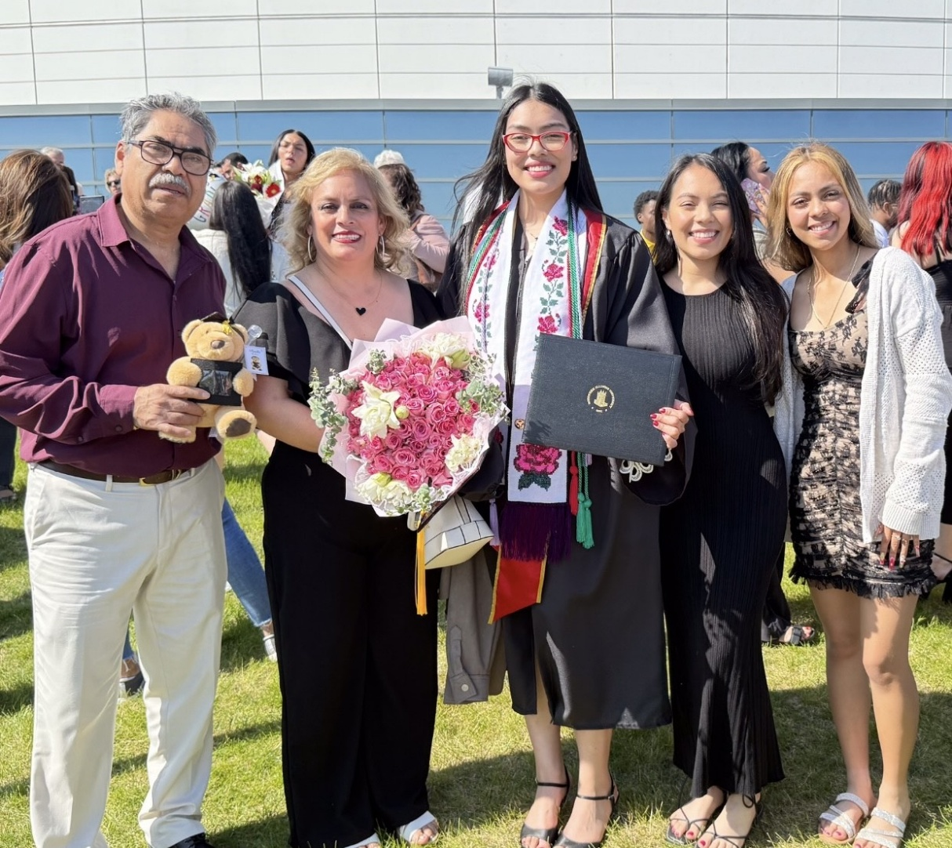
Wendy Lozano, Class of 2025
First-generation college student.
Transferred to NIU from South Suburban College.
Bachelor’s degree in Medical Laboratory Sciences (MLS).
Notes:
I came across MLS bachelor’s degree program – it’s not offered in a lot of Illinois schools.
For me, the one thing that stood out to me is that all the affiliated hospitals the program has – the ability to choose where to do your clinical experiences was important to me.

Slide 7
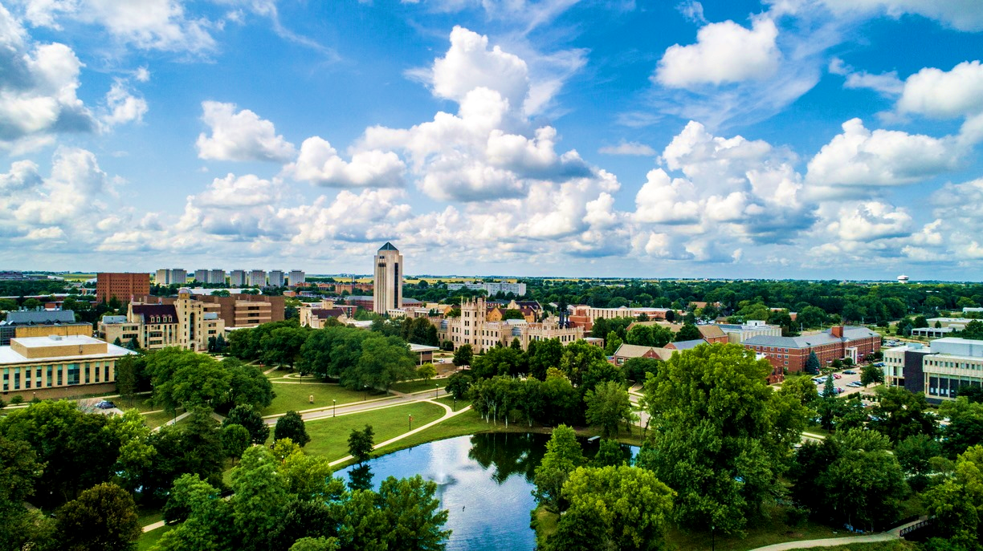
Why NIU?
Close to home.
Medical laboratory sciences bachelor’s degree program.
NIU offers so many affiliated hospitals to choose from!

Slide 8

Scholarships
NIU transfer scholarship
AIM High Transfer Achievement Award
Notes:
The NIU transfer scholarship was granted to me for obtaining a cumulative 4.0 GPA at the time of my transfer, and the AIM High Transfer Achievement Award for meeting the specific criteria set by the state of Illinois.
I had the freedom to explore extracurricular activities and engage with the campus community. This financial support relieved the stress of accumulating debt and empowered me to make the most of my time at NIU
This support allowed me to dedicate more time to my studies and take advantage of all the opportunities NIU has to offer.

Slide 9
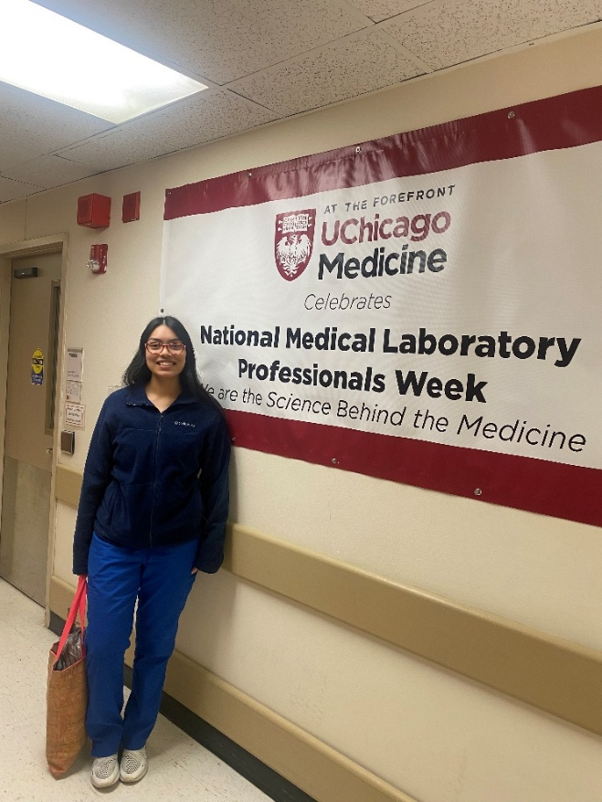
Hands-on learning
August 2024 through May 2025
Working in a real-world
clinical setting
Notes:
The internship was an incredibly valuable experience!
It allowed me to connect what I learned in the classroom to the real-world clinical setting.
I gained hands-on experience with a wide variety of tests, machines, and procedures.
I had a really positive experience during my time at UCMC, so when it came time to apply for jobs, it was an easy decision to apply there. I was excited to be offered a position.

Slide 10
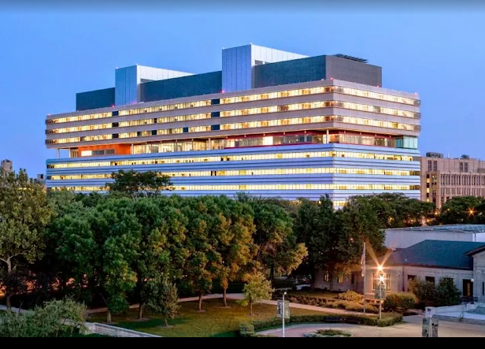


Huskies get hired!
Notes:
I will be starting on June 16! My official job title is Transfusion Medicine Technologist at UCMC.

Slide 11


Huskies get certified!
MLS American Society of Clinical Pathology (ASCP) certification exam
Strong foundation from the MLS program
Hands-on experience during my clinical internship

Slide 12
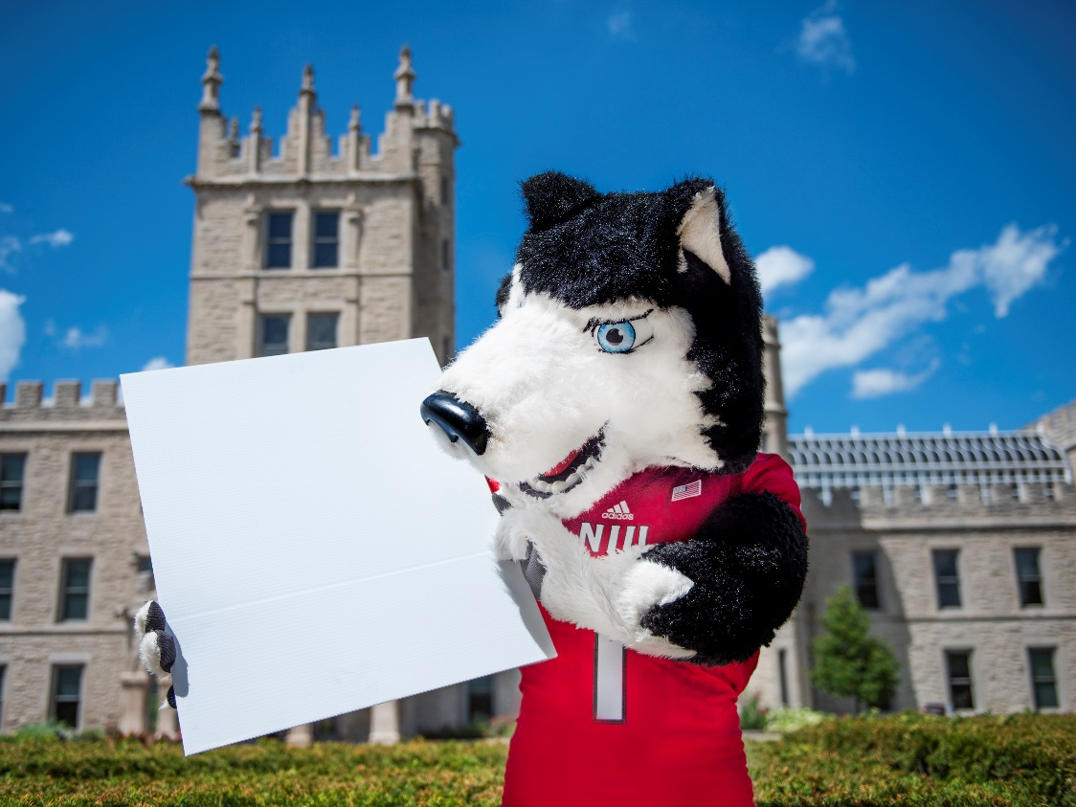
Questions?

Slide 13

Thank you
and
Go Huskies!

