Slide 1
Foundation Update
NIU Board of Trustees Meeting
Thursday, June 12, 2025

Slide 2
Campaign Timeline
Campaign Timeline
LEADERSHIP/QUIET PHASE
PUBLIC PHASE
February #s
$37.2M
$78.6M
$104.5M
$164.5M
FY22
FY23
FY24
FY25
FY26
FY27
FY28
FY29
FY30
EXTENSION or TRANSITION
Continuously Energizing
Our Communities
Cultivating donors with strategic solicitations
Celebrating Campaign donors
Fueling the external MarCom plan
Monitoring and sharing progress to goal
Implementation of recommendations
Case development begins
Campaign begins
Cultivation and solicitation continues
Prep for launch
Prospect research / Gift Table
Case refinement with internal stakeholders
Marquee project and unit case for support development
Campaign Cabinet named
Campaign anthem developed and revealed
Cultivation of key / lead donors begins in earnest
Marts & Lundy Study
Campaign Fundraising Activity
Through 6/5/2025
$164.5M
Campaign Goal
$300M

Slide 3

Campaign Launch Event
Saturday, June 14, 2025 / 2:30 – 5:00 pm – NIU Convocation Center
Our FORWARD: The Campaign for NIU launch event strategy:
showcases our Campaign commitments;
highlights the university’s mission, vision and impact through its academic colleges and support divisions; and
fosters a sense of community and urgency among alumni, donors, community members, students, and supporters.
Through these activities and an ongoing outreach and engagement plan, we will propel excitement around Campaign initiatives and invite all Huskies everywhere to pledge their support for NIU’s continued growth and excellence.

Slide 4
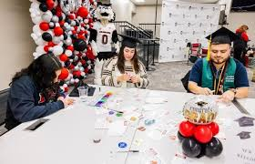
Student Engagement Opportunities:
2025 Gradpalooza
Our 2025 Gradapalooza Event exceeded expectations:
NIU Foundation on-hand to promote senior class gift, as well as selling new grad t-shirts and collecting surveys with updated contact information
58 shirts sold
170 surveys collected, in exchange students received license plate holders
Senior Class gift 122 cords sold at $20 / each, with approximately $10 / each being a gift

Slide 5
Student Engagement Opportunities:
Commencement
Commencement: Two major changes; produced video replacing alumni scripted remarks and congratulations / welcome text sent to each graduate
90 second video was a hit, providing a more entertaining and engaging experience as opposed to another speaker at the end of the ceremony
Texts sent to 1,369 undergrads and 438 graduate students as each respective ceremony closed. Text included a link to a curated landing page featuring upcoming events, how to give, how to update contact information, and volunteer info.

Slide 6
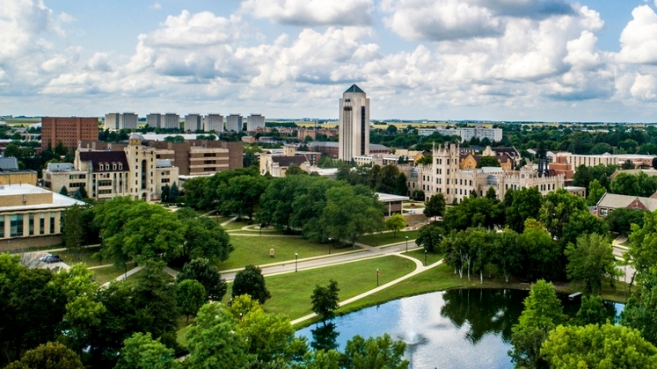
Reflections
Catherine Squires

