Slide 1
Enhancing Health of Older Adults Using Digital Technologies: Our Community Based Partnership Approach.
August 28, 2025

Slide 2
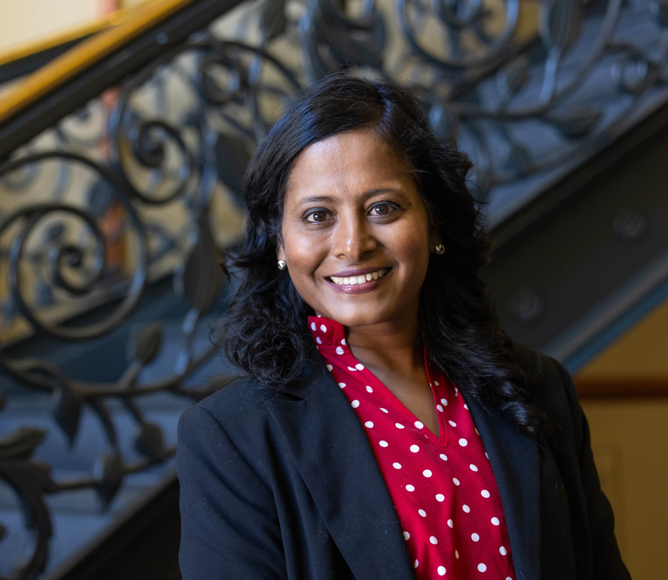
Anitha Saravanan, Ph.D., RN, APRN
Assistant Professor, School of Nursing
17+ years as an RN: cardiac surgery, emergency room, post-op care.
12+ years as a Nurse Practitioner: rehabilitation, pain management.
Notes:
Shorten up – what do you teach – a little about you
Wanted to serve in a research university that values teaching Grounded in both clinical care, research, and academic curiosity.
Worked in NIH studies as Research Assistant

Slide 3
How I found my passion at NIU
Came to NIU in 2020
NIU is a career paradise!
Teach undergraduate and graduate students in courses that include:
Transition to Professional Nursing
Medical Surgical Clinical
Health Assessment
Nursing Informatics
Nursing Research and Evidence Based Practice.
Notes:
What Makes NIU Special?
First time in my 35-year work journey - found a “career paradise”
Explain what you mean by career paradise and why NIU is special

Slide 4

Advancing NIU’s Mission
Equity, Access and Engagement
Serving diverse, underserved communities across Northern Illinois.
Embedding student learning into real-world research.
Advancing health equity and prevention among older adults.
Notes:
NIU is the first place where I’ve felt truly at home. The mission—equity, access, community engagement—is not just aspirational. It’s visible in our classrooms, our fieldwork, and our research. Every project I lead includes students, and every outcome helps build a healthier, more connected community. “At NIU, the mission and vision aren’t just on paper we live in the work we do.”

Slide 5
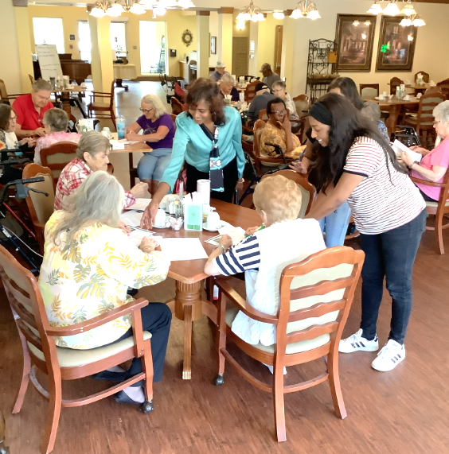
What matters most
Equitable care for older adults and underserved communities.
Bringing students into the community.
Designing studies that reflect the needs of our most vulnerable.
Advancing health equity through education, research and compassion.
Notes:
he lines on this slide are breaking into the logo and don’t seem to have a purpose- I would move this to bullets like on the next slide

Slide 6

Purpose-driven projects with community impact
The discrepancy between people who have access and resources to use new information and communication tools and people who don’t.
Notes:
5: A little more here
COVID – 19 – Personal and Professional experiences
Only 58% aged 55-74 years - used Internet frequently.
Technology use - very limited - above 75 yrs.
46 million older adults - 15% of U.S. population.
By 2050 - 22% Americans = above 65 yrs.
NEED a thesis that is a throughline about the research – GOAL: Enable older adults to be more self-sufficient in their health by helping them access tools to better navigate the world. Also, speak about what the issues are—give us the significance with some data- Older adults BLAH BLAH BLAH—explain digital divide

Slide 7
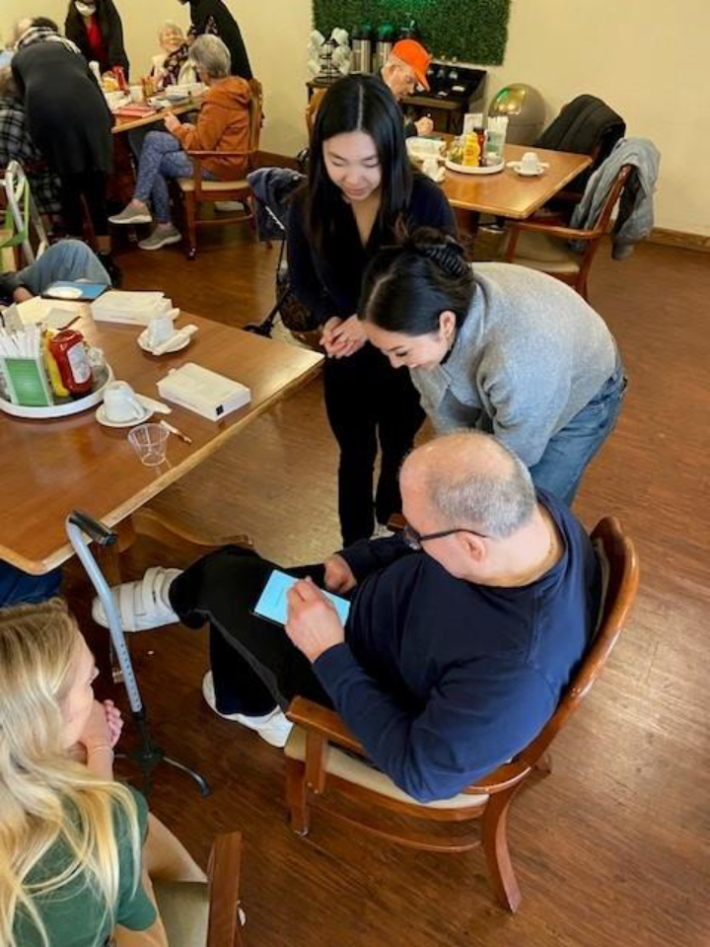
What are we doing about it?
Smart Tablet Education for Healthy Living (STEHL)
Step-by-step approach through our handbook.
One-stop shop for reliable health information through our STEHL website.
One-on-one training provided by our students.

Slide 8
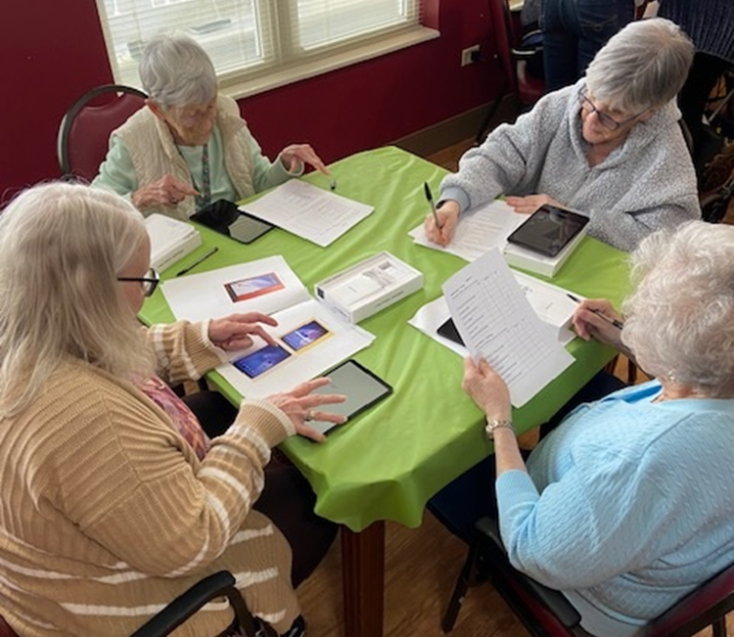
What is STEHL?
Community-based digital literacy program.
Implemented in six retirement homes in suburban Chicago.
Increased access to trusted online health information.
Notes:
Describe what it means to be community-based means and use this to weave into your ethos at NIU
These are just a few of the projects where NIU’s mission comes to life. Through STEHL, we connect students to seniors in need of digital skills. With BRIDGE and DigHAC, we’re exploring how hearing and brain health intersect. Each project centers equity, aging, and real-world solutions.

Slide 9
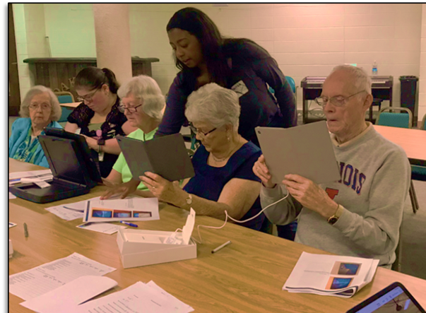
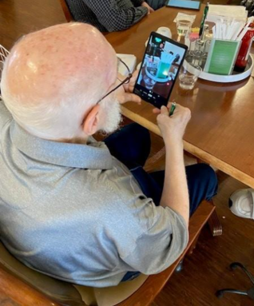
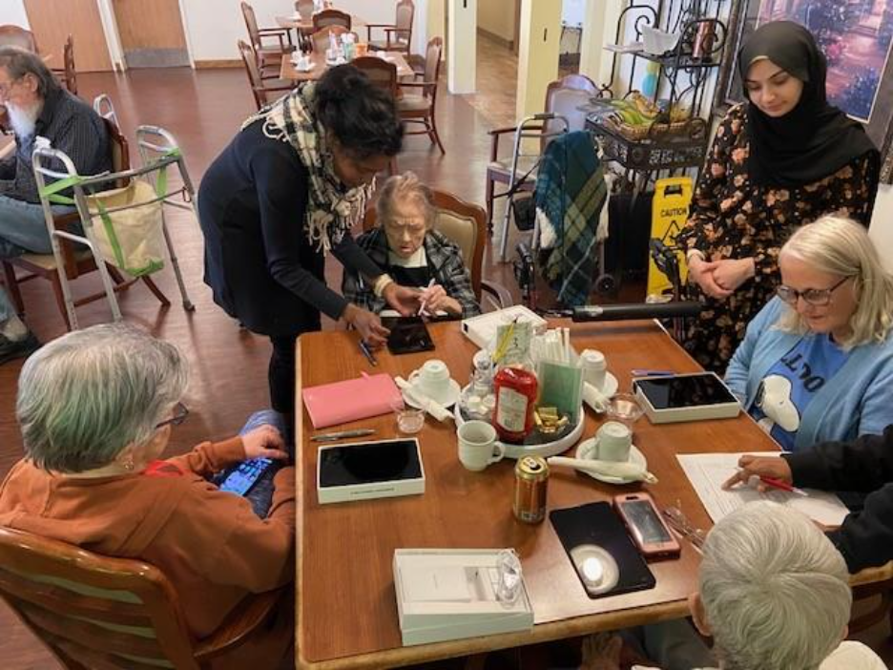
STEHL in action

Slide 10
What participants told us
Notes:
Blue bar is pre-workshop training
Red bar is post-workshop training

Slide 11
Reactions to STEHL project
Notes:
Blue is agree, red is disagree, green is neutral

Slide 12
What’s next?
Building healthier futures together
Training undergraduates through American Heart Association (AHA) DigiHEART-Link
Ensuring NIU is a hub for aging equity and community-engaged science
Notes:
We’re just getting started. With continued support, we’re growing STEHL into rural Illinois, pursuing federal funding, and launching programs like DigiHEART-Link to train the next generation. NIU can lead the way in aging equity and community-centered health research.

Slide 13
How we do it? Thanks to NIU!
It starts with supportive leadership!
Dean Fiala and Dr. Gordon have created space for innovation. Their mentorship and initiatives like Huskie Frontiers, CHHS Special Interest Groups and CHHS
Research Scholars opened doors for research and grants.
UGA – University Grants Academy
Support for research and specifically to involve students in the process.

Slide 14

Thank you for your time!
Notes:
I will now open it up to questions.

