Slide 1
FY 2025 Sponsored Funding Report
Research and Innovation, Legal and Legislative Affairs Committee
August 28, 2025

Slide 2
Topics
FY 25 Sponsored Funding Overview
Shifting Federal Research Landscape
FY 26 Priorities

Slide 3
FY 25 Funding Totals – Sponsor and Program

Slide 4
FY 25 Funding by College/Division

Slide 5
Funding by Sponsor

Slide 6
Funding by Program

Slide 7

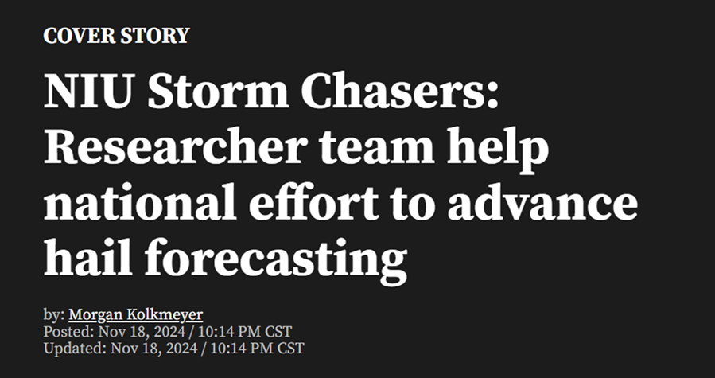

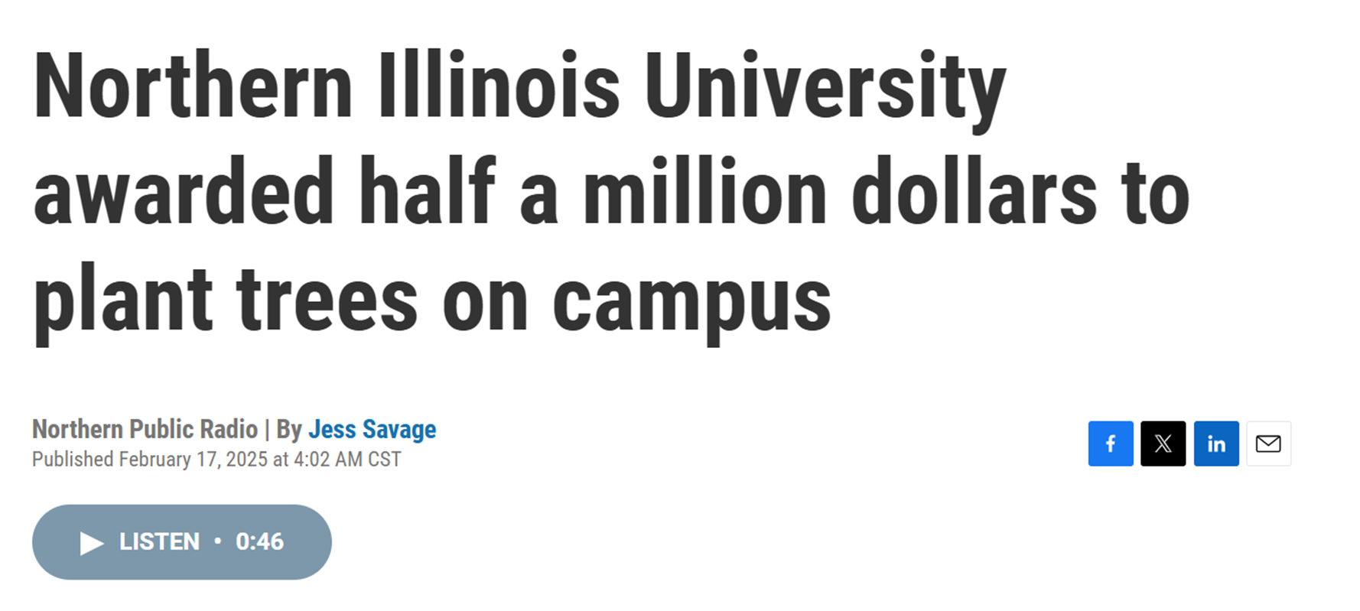

Slide 8
Shifting Research Landscape
57 Executive Orders*
  19 with a known relation or impact to research and federal grant/contract funding
  38 with a potential relation or impact
30+ Agency Notices and Policy Changes
8 NIU Awards Cancelled
5 Lawsuits Joined
Proposed New Federal Overhead Cost Recovery Model – Financial Accountability in Research (FAIR)
Planned Revisions to Federal Grant Regulations
Ongoing Volatility
*Council on Governmental Relations EO Tracker as of 8/19/2025

Slide 9
FY 26 Priorities
Continue Build Out of RIPS Research Services Arm
Shifting Regulatory Environment
Faculty and Staff Support
Move Research Intelligence Forward
Higher Ed R&D Survey – Research Expenditures
Data Visualization – More Dashboards
Risk Mitigation – Improve Grant Financial Reports
Data Collection and Reporting – Support Decision-Making
Monitor/Respond to New Proposed Overhead Model (FAIR)
Modeling
New Budgeting Structures
Adjustments to University Financial Systems
Financial Reporting and Audit

Slide 10
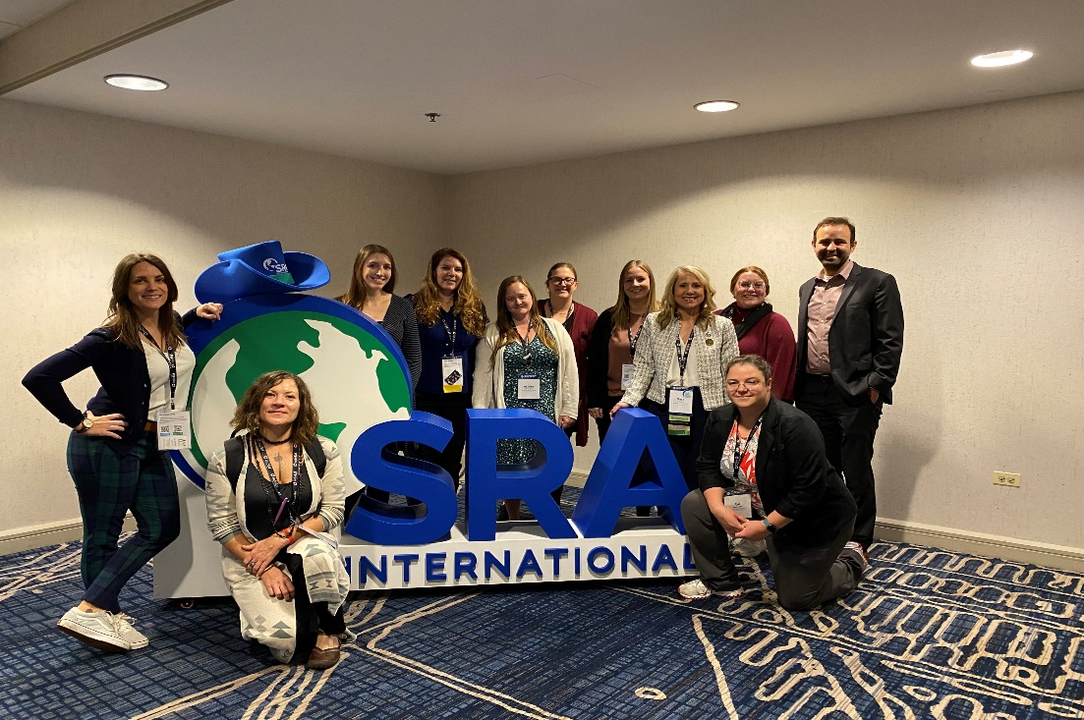
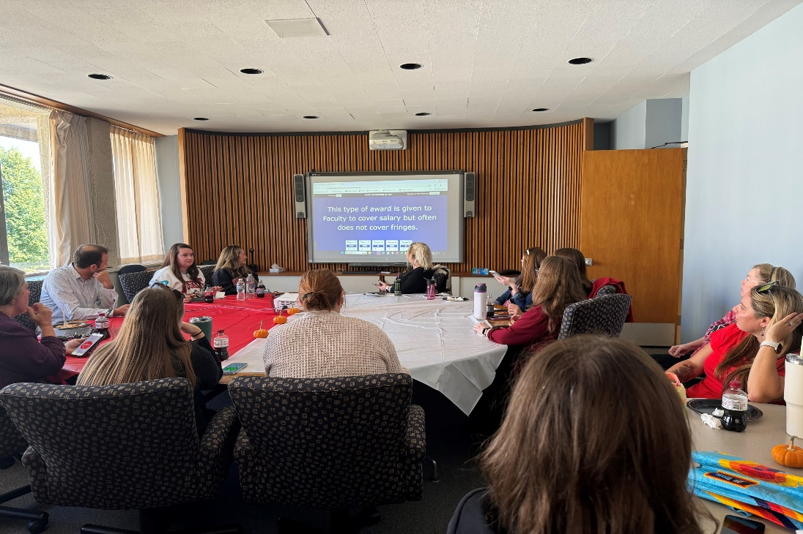
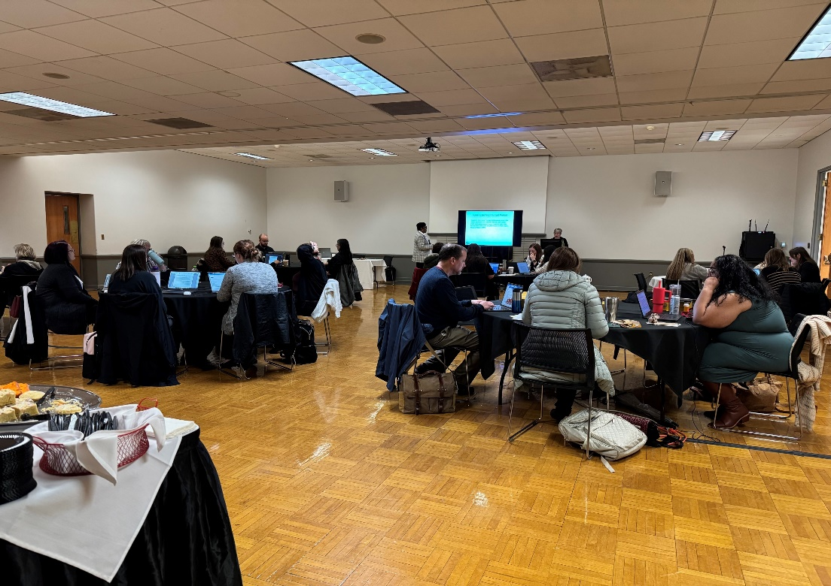
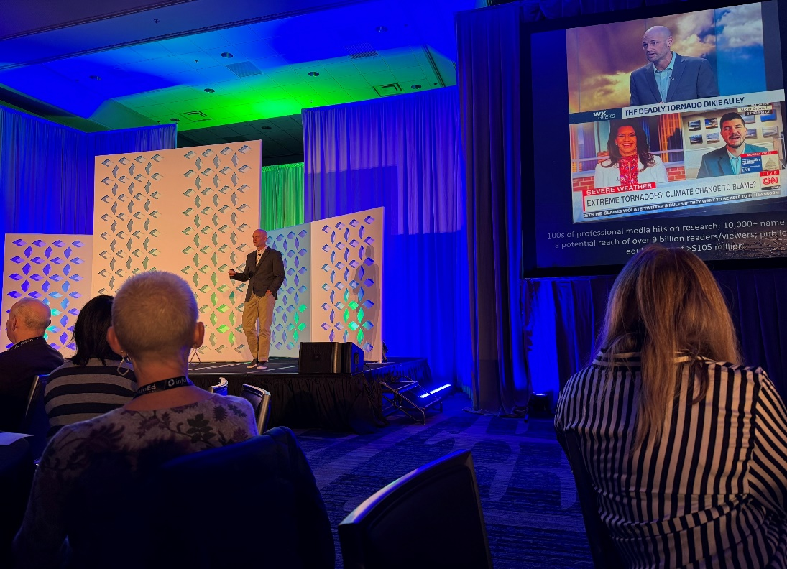
Various pictures including people posing for pictures, sitting around tables and giving a presentation.

Slide 11

Thank you – questions?
People holding signs that say Research Improves Your Life.

