Slide 1
FY24 Capital Investment Review and Forecast
FACFO
February 2025

Slide 2
Overview
Sustainment/Capital Renewal Investments
  Big picture trend and forecast
  Current efforts
Capital/Modernization Investments
  Big picture trend and forecast
  Current efforts
Strategy Review
  Energy Improvements
  Space management
University Goal 6B: Advance Facilities and Technology Planning Priorities
Advance state capital projects including NICCS and the Baustert Bahwell Health Technology Center.
Advocate for release of state funding for capital improvement.
Fully deploy the NIU Master Planning Framework in the campus capital planning advisory group to guide capital planning and align facilities and technology projects with our strategic priorities.
Increase revenue generation and/or reduce expenses through streamlining and maximizing facilities usage. This will include, but not be limited to, implementation of the NIU-Trane Energy Savings Agreement

Slide 3
Sustainment Investment Trend/Forecast
Annual target to keep pace with deterioration
Underinvestment Void
Peak investments
Capital Renewal Projects
Highest maintenance and repair investment over past 25 years
Continues to climb as remaining Capital Renewal repair investments play out

Slide 4
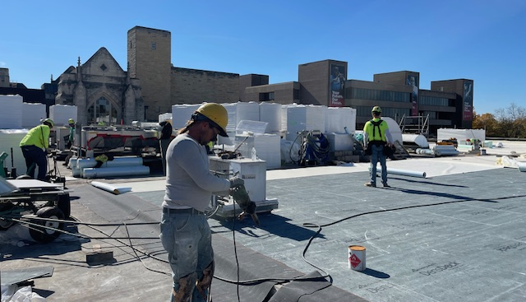
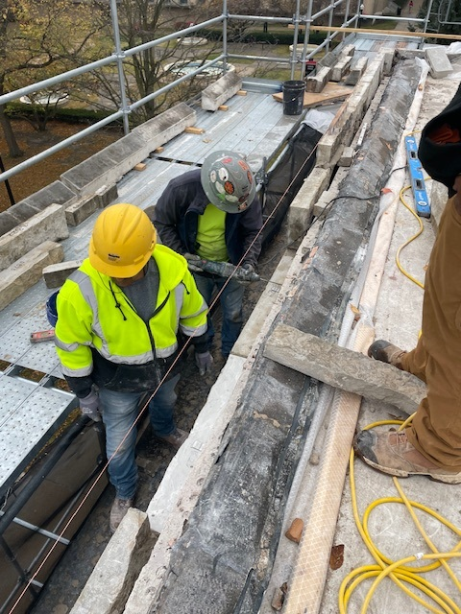
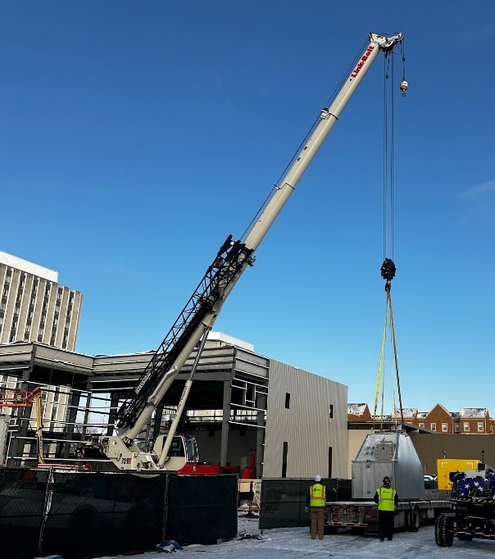
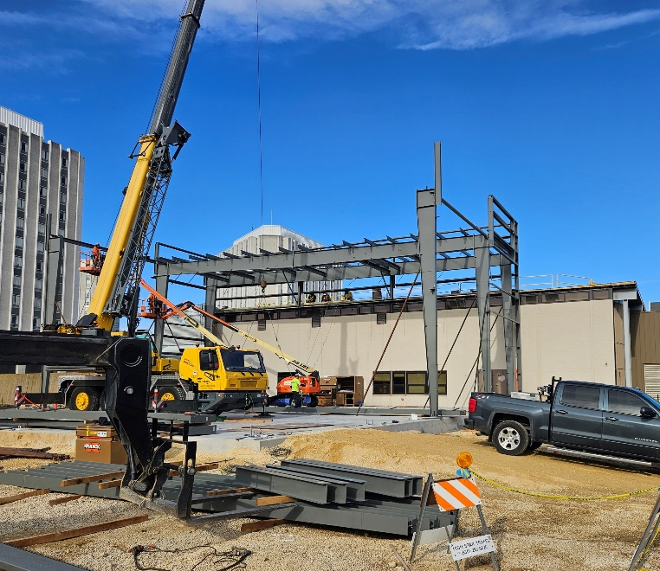
Active Capital Renewal Projects
Visual Arts Bldg structural repairs($4.9M)
  93% completed; East side repairs postponed to summer 2025
Campus boiler replacement ($20.6M w/ $9.8M NIU $)
  Pre-Engineered building under construction, boilers placed
  Completion ~early 2026
Swen Parson Hall roof repairs($5.7M)
  71% completed, spring 2025 completion
Gabel Hall and Music Bldg roof repairs ($4.2M)
  Design in process – targeting early spring bid and summer/fall execution
Swen Parson roof
Swen Parson roof
Boiler addition

Slide 5
Capital Renewal Overview
State appropriation since FY19/20: ~$70M
Completed work (as of FY24) - $16M
Active projects uncompleted work: - $19M
Remaining allocation: ~$35M
General Assembly capital appropriation
(unexecuted portion reappropriated each year)
Governor’s Office of Mgmt and Budget
(general obligation bonding)
Capital Development Board
(Planning Design Construction)
Capital Renewal statistics:
  23% executed
  27% in motion
  50% remaining

Slide 6
Capital Renewal – Future Priorities
Priority | Project Title | Est. Cost ($K)
1 | Anderson Structural Repairs & Stills Masonry Repairs(Appropriated) | 7,875
1a | Boiler replacement project – (Funding switch out for NIU contribution) | 9,839
2 | Electrical Infrastructure Upgrades | 5,000
3 | DeKalb Campus – Roof repairs and replacements | 5,000
4 | DeKalb Campus – Elevator Upgrades | 5,000
5 | DeKalb Campus –Fire Protection Upgrades – Phase I | 5,000
6 | DeKalb Campus – Heating system piping conversions – Phase I | 12,000
7 | DeKalb Campus – HVAC and Hood Exhaust repairs – Phase I | 5,000
8 | Academic Buildings – General upgrades – Phase I | 6,000
9 | DeKalb Campus – Surplus building demolitions | 4,000
10 | Campus Wide Boiler Decentralization – Phase I | 9,000
11 | DeKalb Campus - Building envelope/windows upgrades | 4,000
12 | DeKalb Campus – Building Access Control | 2,000
13 | Altgeld Hall – Building Automation System | 4,000
14 | DeKalb Campus – ADA Assessment and upgrades – Phase I | 5,500
15 | Water main replacements – Phase I | 6,000
16 | Electrical Infrastructure upgrades – Phase II | 7,000
17 | DeKalb Campus – Boiler upgrades (decentralization) – Phase II | 25,000
18 | DeKalb Campus – Heating system piping conversions – Phase II | 8,000
19 | DeKalb Campus – HVAC and Hood Exhaust repairs – Phase II | 3,000
20 | Academic Buildings – General upgrades – Phase II | 11,000
21 | Chilled water system upgrades | 25,000
22 | Campus Wide Boiler Decentralization Phase III | 25,000
 | Total Capital Renewal Projects | $199,214
Current
Authorization
Share of $450M?
Indication of $450M to be invested across all higher ed
If ~$40M
~$200M
Priorities submitted with FY26 IBHE RAMP

Slide 7
Capital Investment Trend/Forecast
Actual
Cumulative Deferred Maint
Cumulative Deferred Maint
Capital
?
COB
Annual target to keep pace with deterioration
Capital Renewal
BAVC
Cole
Stevens
Altgeld

Slide 8
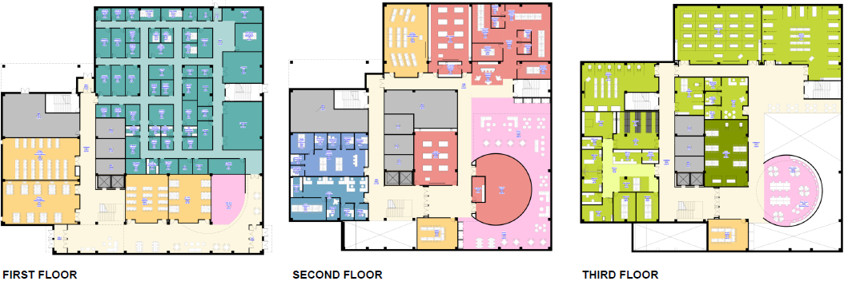
Active Projects - BBHTC
Timeline
  Schematic Design thru Mar 2025
  Design Development Spring-Fall 2025
  Construction documentation prep Fall-Spring 2026
  Bidding/Contracts Spring-Summer 2026
  Construction Fall 2026 thru Summer 2028
Leveraging $10M of $40M donation to enhance support for interdisciplinary/collaboration spaces
1st floor
2nd floor
3rd floor

Slide 9
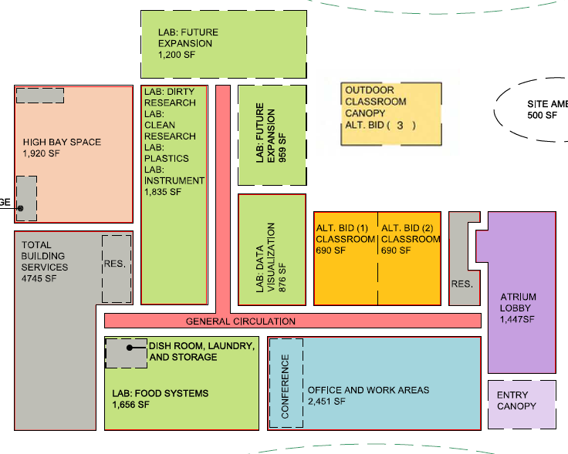
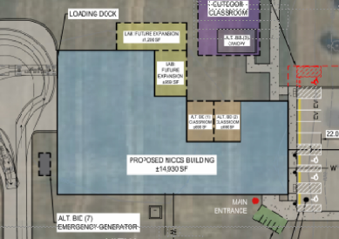
Active Projects - NICCS
Timeline:
  Design/Build RFP process Spring to Summer 2025
  Design/construction window Fall 2025 to Fall 2026
Philanthropic commitment
  $2.5M to enhance sustainable amenities
Main features
  Open and enclosed meeting spaces
  Lab spaces focused on food systems, water resources, and environmental adaption

Slide 10
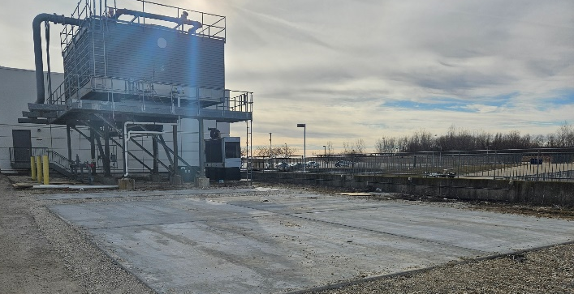
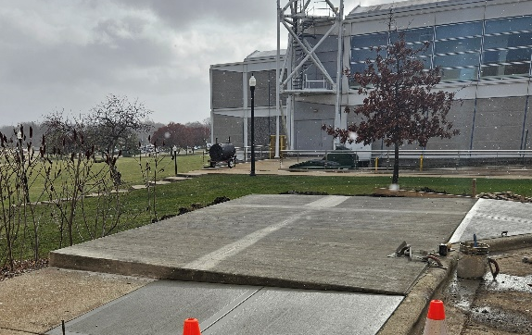
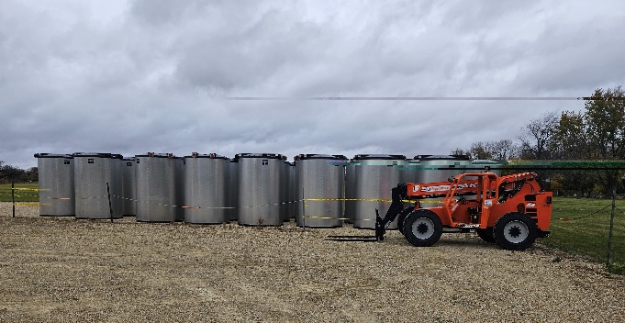
Active Projects - Energy
Energy Improvements project
  5% expenditure threshold achieved for Federal 48ITC incentive by 2024 end (solar & thermal energy storage work/materials delivered on site)
  Near-term activities
    Building envelope, HVAC controls and lighting improvements begin Feb and March
    Water conservation, solar install and HVAC equipment upgrades begin April and May
  Overall completion anticipated by summer 2026
  More on energy monitoring strategy with next update
Thermal tank pads placed
Convocation Center
Barsema Hall
Thermal Energy Storage Tanks

Slide 11
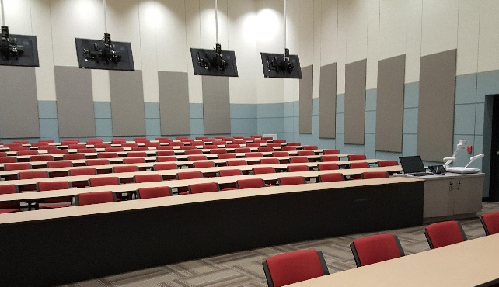
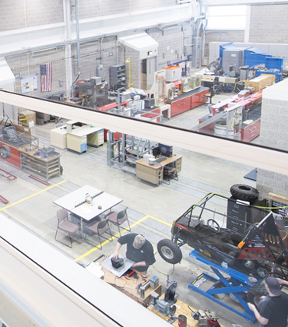
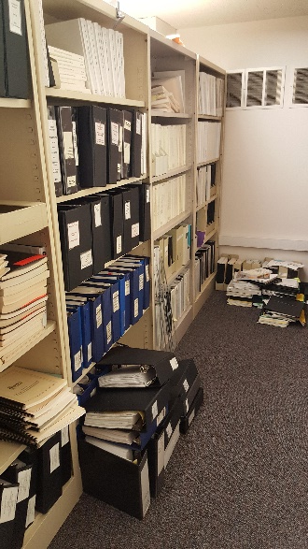
Strategy on Space
Challenge recognized
  Space costly to build and to sustain
  Growing demand for repairs and modernization
Mindsets about space changing
  Being sustainable
    Fiscally & environmentally
  Reevaluating space needs
Long-term planning focus
  Master planning framework incorporated into process
  Target investments to address identified gaps in performance categories
    Financial objectives of significant interest presently
Classrooms
Labs
Storage ?
Commitment to use less and share more

Slide 12
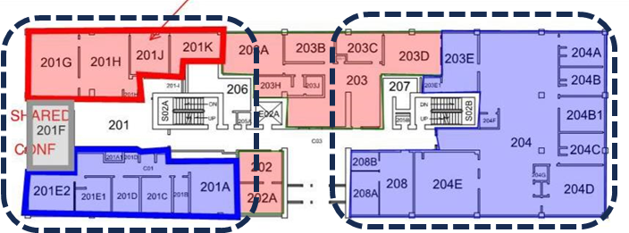
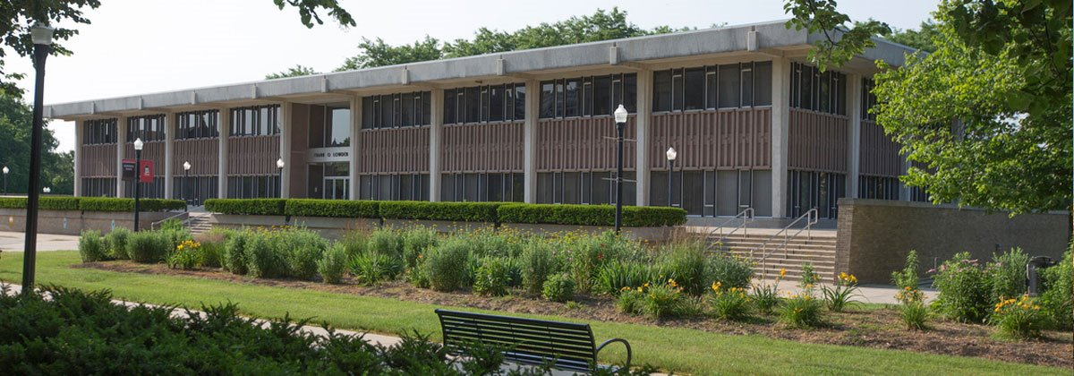
Space Utilization
Surplus disposed/pending (5% reduction to date)
  Represents ~$3M of cost avoidance annually
    Based on repairs, maint., utilities, and support services
Space repurposing
  Lowden Hall - remote working to free up ~10 KSF
Leasing – Net revenues highest since FY17 and projected to double by FY26

Slide 13
Summary
Growing maint/repair investment
  Highest investment point in 25 years
  Projected to double average annual investment from past decades
  Push for state capital renewal support to continue
  Need for improved pace of state project execution
Future modernization
  NICCS and BBHTC in final “pre-construction” stages
  More modernization investment needed
Focused investments for future
  Consolidation for more sustainable footprint

Slide 14
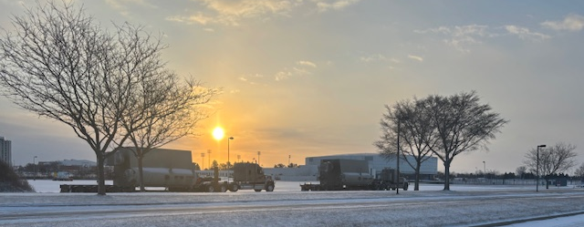
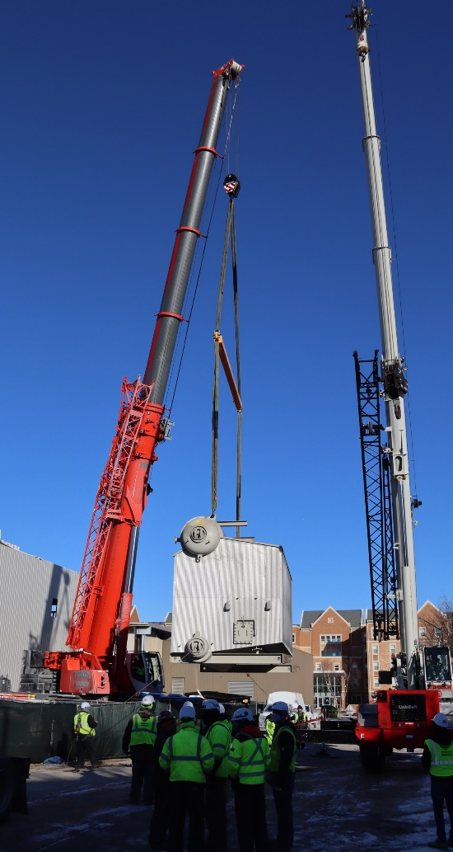
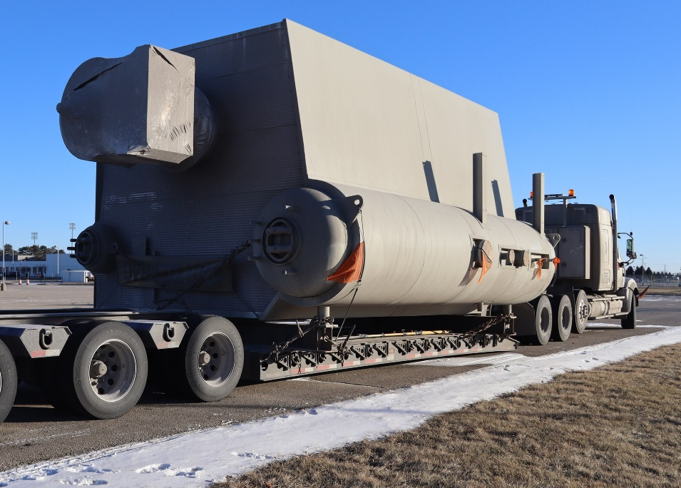
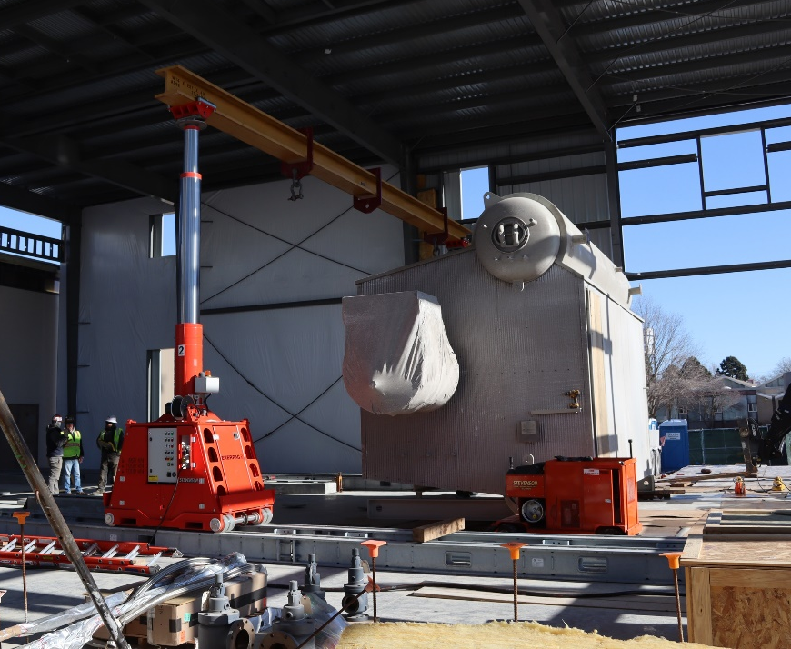
Questions?
Boiler arrival/placement Jan 2025

