Slide 1


Jinsook Kim, Ph.D., M.P.H., D.D.S.
Presentation for the Board of Trustees
February 20, 2025

Slide 2
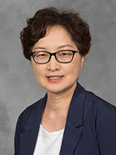
My Path to NIU
I earned my D.D.S. (Dentistry) from Seoul National University, Seoul, Korea.
Master of Public Health (M.P.H.) from Johns Hopkins University.
Ph.D. in Public Health from University of California – Los Angeles (UCLA)
Notes:
Share a little about your background and how you came to NIU.

Slide 3
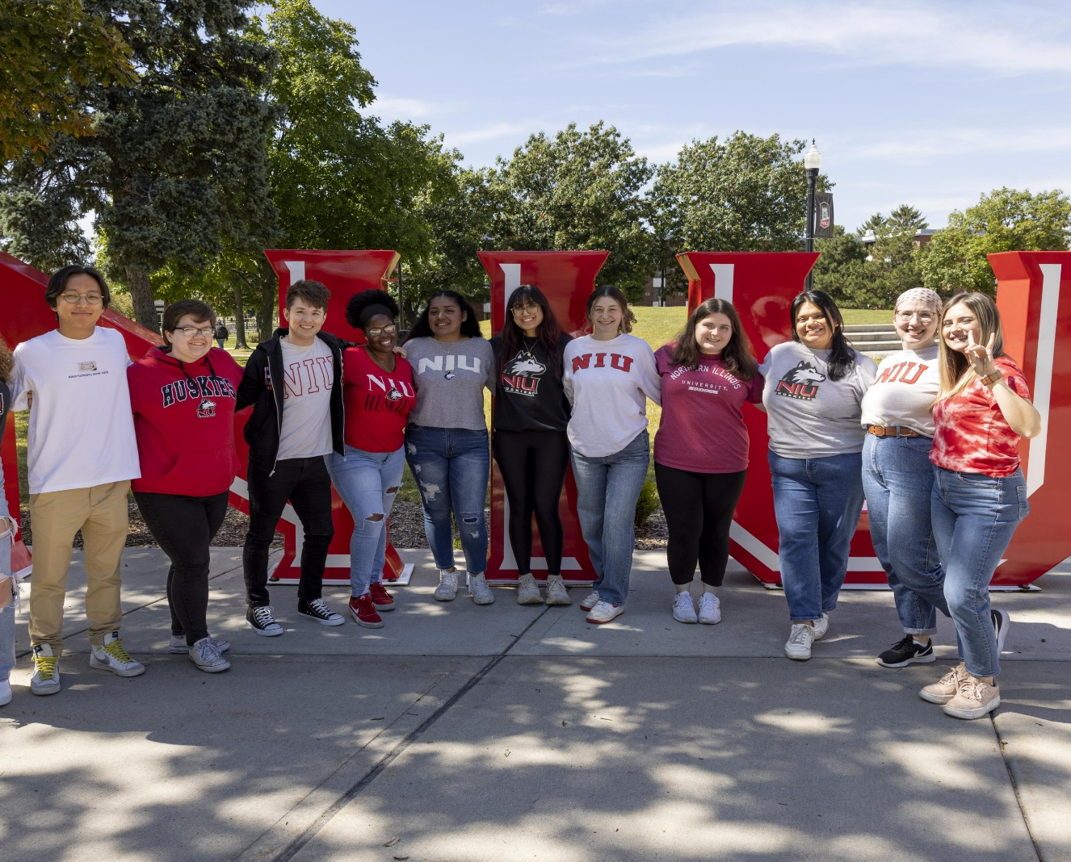
Proud to Be a Huskie
I came to NIU in 2006 as a visiting assistant professor and have been a full professor in the College of Health and Human Sciences since 2019.
NIU is a special place because of the students we serve.
Notes:
Explain why you enjoy working here!

Slide 4



Courses Taught
PHHE 315: Introduction to Health Promotion
PHHE 611: Applied Research Methods in Public Health
PHHE 669: Community Health Planning
PHHE 698: Master of Public Health Integrative Learning Experience
Notes:
As a professor in the public health degree program, I teach courses…

Slide 5
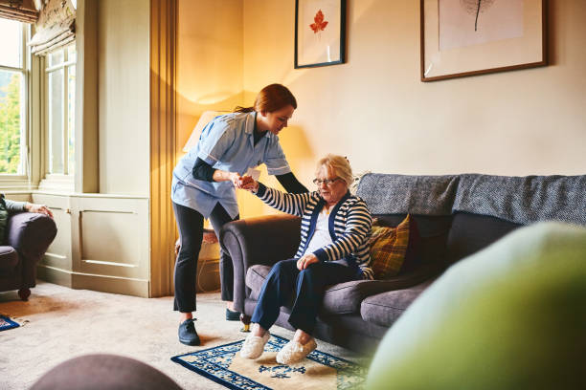
Research Interests
Direct care workforce
Health promotion using digital technology
Palliative care training for direct care workers

Slide 6
Sabbatical: Fall 2021
“How Confident Direct Care Workers Are in Providing Palliative Care?”
Notes:
Before discussing how my sabbatical impacted our students, my teaching and the community, I wanted to share a brief overview about my research.

Slide 7
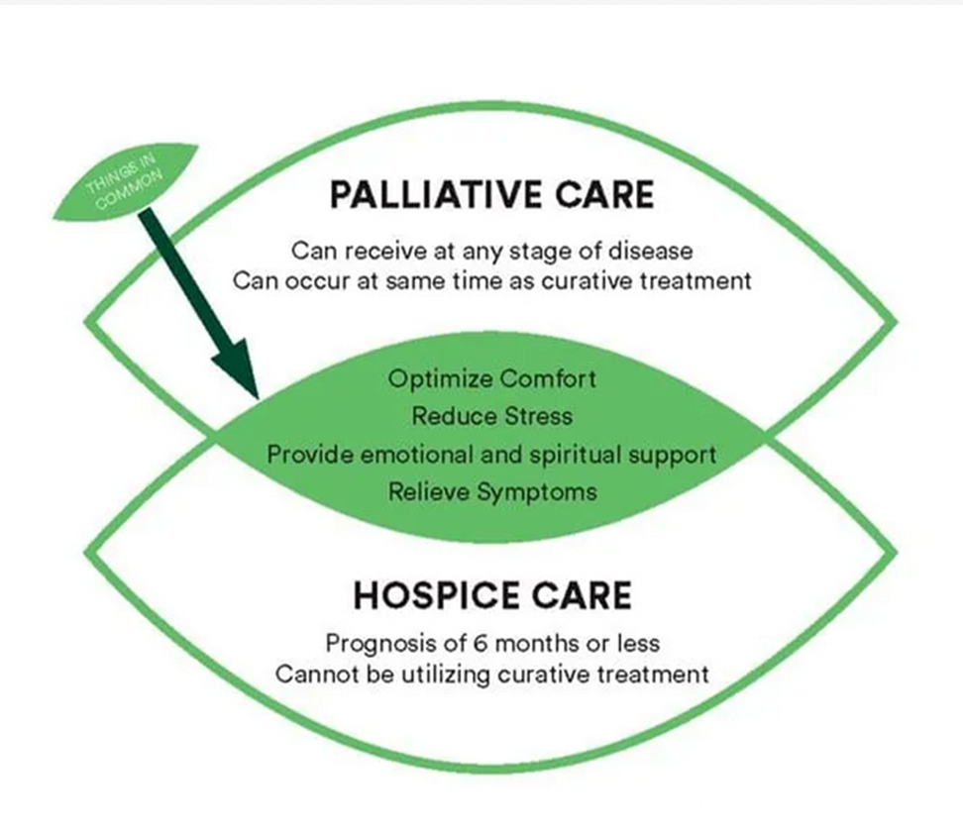

What is Palliative Care?

Slide 8
Who Are Direct Care Workers?
Spend the majority of their work time assisting patients.
Provide personal care, assistance with daily activities and clinical support.
Can perceive important aspects of and changes to patients’ health status, such as mobility, pain, cognitive health status and emotional health.
Help patients and family members communicate with other members of the palliative care team.
Notes:
Palliative care team: a team of physician, nurse, social worker, and other health professionals including direct care workers
Direct care workers in intellectual and developmental disability (IDD) service agencies and nursing homes
Provide day-to-day, non-medical, supportive care for residents, and carrying out directives
High school education
Mostly female and people of color
Severe workforce shortages

Slide 9
Training for Direct Care Workers
No continuing education requirements by the state.
Training left on individual facilities.
Receive insufficient training on palliative care.
Direct care workers and their supervisors feel the need for palliative care training.

Slide 10
Research Outcomes
Developed two new instruments that reliably and accurately assess the level of confidence of direct care workers regarding palliative care.
The instruments can be used to evaluate the effect of training programs.
By using the instruments, educators and supervisors can identify weaknesses of and ways to improve existing training.

Slide 11
Student Engagement and Involvement
From 2016 through 2021, I was able to employ and supervise seventeen undergraduate and graduate students related to this research topic.
These efforts provided the foundation for the sabbatical research project.
Notes:
My sabbatical allowed me the time to focus on research. Along with developing the new instruments, it afforded me the opportunity to involve Huskies in the work, incorporate what I learned into my teaching, publish articles and obtain an external grant.

Slide 12

Into the Classroom
Introduction to Health Promotion
(PHHE 315)
Direct care worker-related issues, such as workforce shortages and training issues, are included in readings and discussed during the presentations in related modules.
Applied Research Methods in Public Health (PHHE 611)
Findings from these studies are used as examples by including published articles in the reading list.
Notes:
Research findings are integrated into teaching.

Slide 13

Publications and Grants
Published two articles in peer-reviewed journals as a direct result of the sabbatical research.
Published five more articles in peer-reviewed journals after the sabbatical leave.
Obtained an external grant in 2023 as a result of research collaboration with colleagues at UIC during the sabbatical leave period.

Slide 14
Related Projects
Direct support professionals’ palliative care training needs. Tri-County Endowment Award (2016-2017 AY).
Online palliative care training program for staff serving people with intellectual and developmental disabilities. Broadband Innovation Grant, (2016-2017 AY).
Certified nursing assistants’ palliative care training needs. Broadband Innovation Grant (2017-2018 AY).
Pilot testing of an online palliative care curriculum for direct care workers (DCWs) serving older adults with cognitive impairments. Tri-County Endowment Award (2017-2018 AY).
Palliative Care Research Project. Graduate School Great Journeys Assistantship, (2018-2019 AY). (Elizabeth Corning (PhD), mentee).
Self-paced online palliative care training intervention for certified nursing assistants. Division of Research and Innovative Partnerships Research and Artistry Grant, Northern Illinois University (2018-2019 AY).

Slide 15

Valuable Experiences
A sabbatical impacts:
Students
Faculty
Community
Notes:
I greatly appreciate the university’s support for my sabbatical research.
I thank Dr. Jennifer Gray, also a public health professor at NIU, who is a partner of multiple research projects.

Slide 16
Thank you for your time!
Jinsook Kim, Ph.D., M.P.H., D.D.S.
Professor, Public Health
School of Health Studies
College of Health and Human Sciences
815-753-1352 | jkim4@niu.edu
www.chhs.niu.edu/about/staff/kim-j.shtml

