Slide 1
Open Access and Scholarly Communication
Presentation to RILLA, NIU Board of Trustees May 13, 2021 – Fred Barnhart

Slide 2
Open Access is …
… a publishing model for scholarly communication that makes research information available to readers at no cost, as opposed to the traditional subscription model in which readers have access to scholarly information by paying a subscription (usually via libraries).

Slide 3
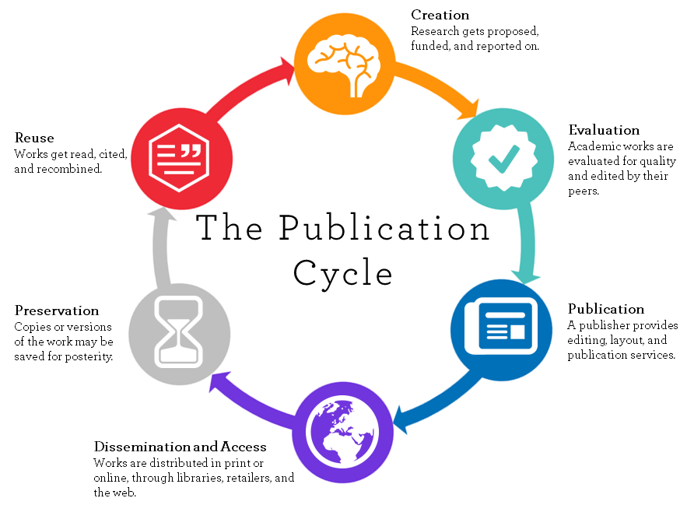
Scholarly Communication:

Slide 4
Who is working and paying?
Researchers work
Funders and Universities pay
Researchers work
Universities pay
Researchers work
Universities and Publishers pay
Libraries work
Universities pay
Publishers work
Publishers pay
Libraries work
Universities pay

Slide 5
Why does OA matter?
Costs
Equity
Dissemination of information
Development of new knowledge
Reputation enhancement

Slide 6
Profit by Publishers:

Slide 7
Citation impact:
Gargouri Y, Hajjem C, Larivière V, Gingras Y, Carr L, Brody T, et al. (2010) Self-Selected or Mandated, Open Access Increases Citation Impact for Higher Quality Research. PLoS ONE5(10): e13636. https://doi.org/10.1371/journal.pone.0013636

Slide 8
Growth of OA:

Slide 9
Challenges of OA:
Publishing model is still in transition
Predatory publishers
Who pays?
Peer review
Copyright
Reputations and impact
Long term archiving and retention

Slide 10
What is NIU doing?
Huskie Commons, NIU’s institutional repository
Library and RIPS provide Author Publishing Costs (APC)
Open access journals
Advocacy
Education

Slide 11
Questions?

